Slide 1
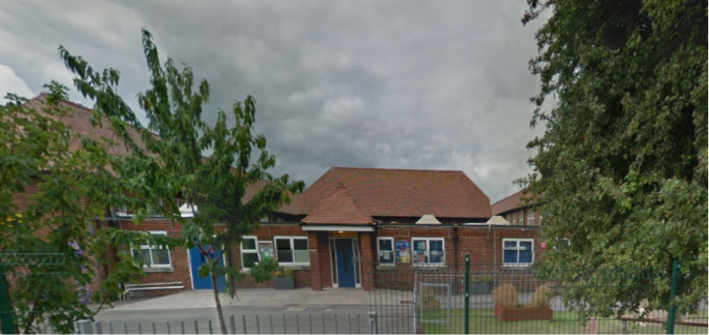


LAC and vulnerable learners at Christchurch Primary School

Slide 2
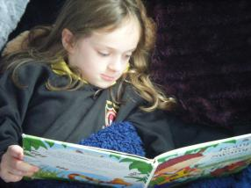
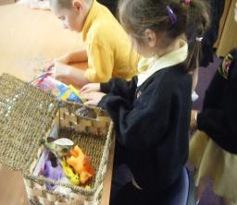
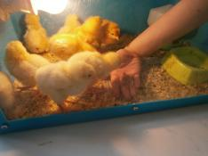
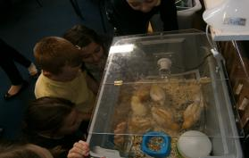
Nurture Provision
We started five years ago with a specific need in Foundation Phase with a group of children with behaviour issues.
Very quickly it became apparent that this provision had a massive positive impact on the child’s day.
We focus on positives and building the children’s self esteem and ensuring that they feel proud of their achievements.

Slide 3
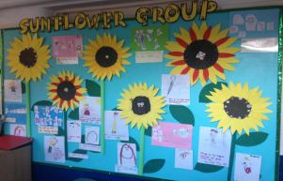
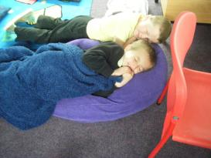
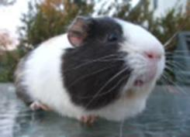
Nurture Groups
We offer a weekly and termly reward scheme.
We have now progressed to a Nurture provision for Years three and Four and Five and Six.
We are now able to identify children much earlier to ensure that we are able to make a difference (family history).

Slide 5
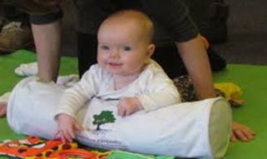
Rhythm of Life
In 2013 we ran Roots of Empathy as a pilot scheme and for the last couple of years we have followed the curriculum.
It is an evidence based classroom programme that has shown significant effect in reducing levels of aggression among school children, raising social/ emotional competence and increasing empathy.
We have now created our own programme called Rhythm of Life.
We are currently running the programme across Year 4 and it involves a baby for each class, visiting every third week.

Slide 6
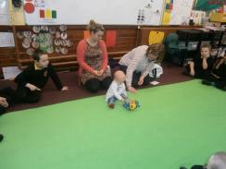
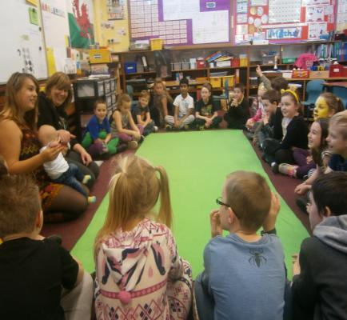

Rhythm of Life

Slide 7
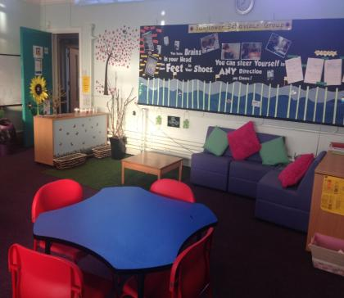
Sunflower Behaviour Group
Currently 6 Year 4 children attend this group along with three members of staff. The group runs three afternoons a week.
Staff carried out class observations over a three week period before the group was selected.
Through these sessions the children follow the Year 4 curriculum in a supportive environment.

Slide 8
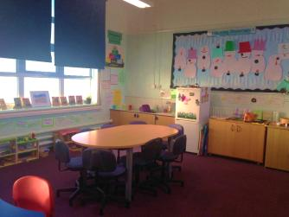
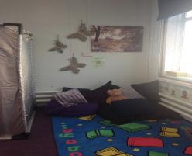
The afternoons follow a very structured routine beginning with relaxation, a review of their morning and then afternoon activities followed by a PE session.
A reward scheme is in place where the boys have the opportunity to progress quickly and earn certificates and prizes.
We have had a great deal of success with the creative side of the curriculum.

Slide 9
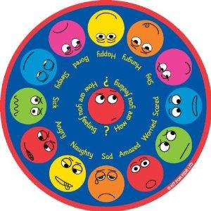
Additional Nurturing Programmes
Drawing and Talking art therapy programme which is carried out 1:1.
Self esteem programmes that can be 1:1 or small group.
Anger management and behaviour programmes 1:1 or small group.
Dino school behaviour programme for Foundation Phase.
Lola - helping young children to listen programme
Unearthing programme which can be 1:1 or small group.

Slide 10
Boxall Profile

Slide 11
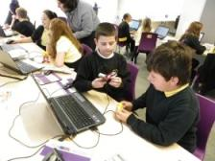
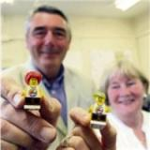
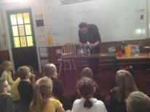
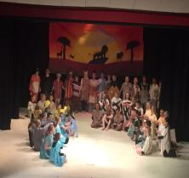
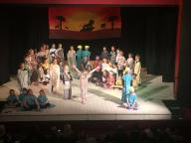
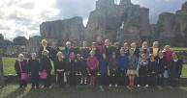
LAC Activities and Trips
G2G Lego
Football with Wrexham Football club
Techniquest in Wrexham
Horse riding
Danger point

Slide 12
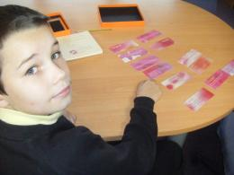
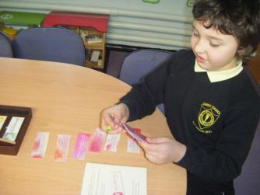
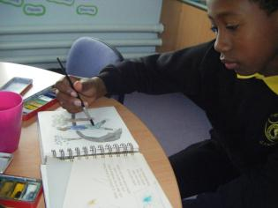
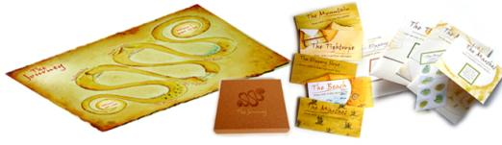
Unearthing

Slide 13
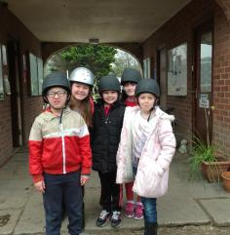
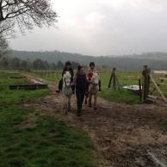
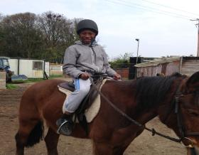
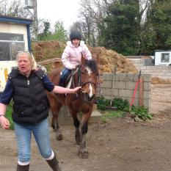
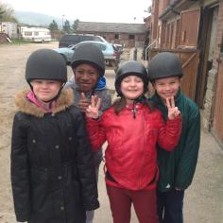
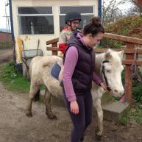
Horse Riding

Slide 14

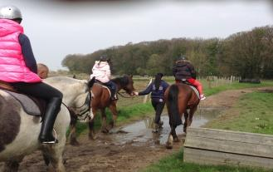
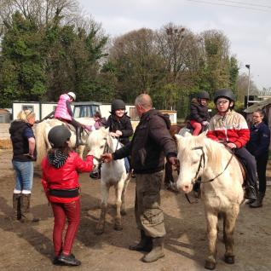
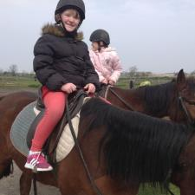
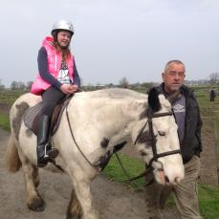

Slide 15
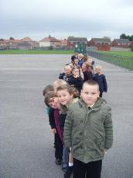
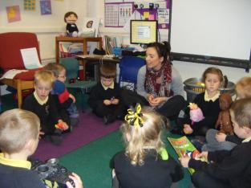
Attendance
Attendance is the central focus of our nurture and behaviour support that we have in place for our LAC and vulnerable learners.
We have spent a lot of time building strong relationships with all parents and carers.
In 2015 we had an inspection by Estyn. The inspectors were very impressed by the whole school approach and the involvement of all members of staff.

Slide 16
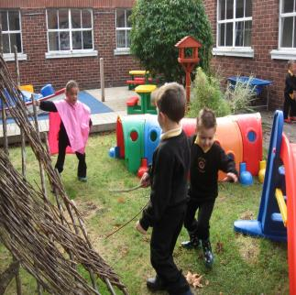
Attendance Rewards
Children receive a class certificate each week if they achieve over 92% and there are also two trophies for the highest attendance in Foundation Phase and Key Stage Two.
Individual 100% attendance certificates are given out at the end of the end.
At the end of the school year any child with 100% receives a certificate and prize presented by the governors.
We have a Denbighshire protocol for any attendance issues but we always attempt to work with the parents and carers in the first instant.

Slide 17
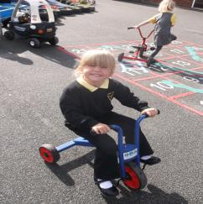
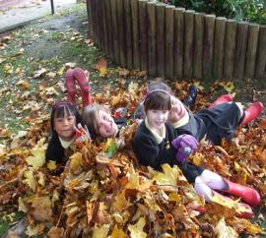
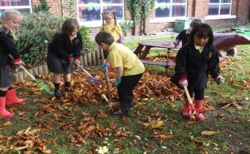
Conclusion
Combination of strategies
Nurture groups and 1:1 sessions
Learning Mentors
Raising self esteem
Raising aspirations
Activities and day trips

