Slide 1
Identifying and Responding to Child Neglect in Schools in Wales
Victoria Sharley Doctoral Student
School of Social Sciences, Cardiff University

Slide 2
Summary
______________________________________________________________________________________________________
Background
Aim
Method
Research questions
Sampling frame
Data collection
Challenges
Initial Findings

Slide 3
Background
______________________________________________________________________________________________________
Child neglect is the most common form of child maltreatment in Wales. Neglect is often chronic, rather than based on a specific incident, its difficult to know whether the care a child is receiving is poor enough to be labelled neglect
It is usually broad-based with a range of causes, making it more challenging to provide comprehensive and timely help to improve the child’s situation sufficiently
The Welsh Government commissioned the Child Neglect Project to research existing practice in Wales and identify key areas for action on child neglect. The project identified schools as pivotal sites for identifying and intervening in cases of neglect
At school children are seen for many hours each week, enabling observation of children and their interactions. This study aims to evidence to what level, and in what form, Welsh schools provide informal support to neglected children
(Statistics for Wales, 2014; Radford et al, 2013)

Slide 4
Aim of Study
______________________________________________________________________________________________________
The project aims to provide further insight by investigating preventative and early intervention provision, in terms of how schools are currently playing a part in efforts to identify and respond to neglect.
The project has three key objectives and aims to provide evidence that will inform good practice between education and social services sectors by investigating:
the extent of involvement of mainstream primary and secondary schools in identifying and responding to child neglect
2. the relationships between education and social services in responding to children and their parents when they are concerned that a child is experiencing neglect
3. the experiences of school staff in a range of different roles when responding to children and their parents, when concerned a child is being neglected
(Legislation Online, 2015; Welsh Government, 2015)

Slide 5
Method
______________________________________________________________________________________________________
Phase 1
Quantitative analysis of children’s social work case files from three different Local Authority areas in Wales (n=150).
Phase 2
(a) Qualitative school-based case studies in each of the three local authorities (n=6), one primary and one secondary school in each area. Five semi-structured interviews with a range of teaching and non-teaching staff, to explore experiences, feelings and needs regarding neglect (n=30).
(b) Non-participant observation of school-based ‘highlighting’ meetings and safeguarding roles will explore the decision-making process around referrals to outside agencies.
(Bryman, 2001; Atkinson & Coffey, 1997)

Slide 6
Methods
______________________________________________________________________________________________________
Phase 2
Phase 1
Quantitative Case-file Analysis
to understand the level of current involvement of schools in responding to chronic neglect in a multi-agency environment
Non-participant Observation
to investigate decision-making processes in schools for implementing different levels of support
Qualitative Semi-structured Interviews
to explore the early identification of neglect by school staff
Universal services
Children with additional needs
Children with multiple needs
Children at risk in need of protection
(Gorad & Taylor, 2004; Floersch, 2000)

Slide 7
Research Questions
______________________________________________________________________________________________________
How do staff in primary and secondary schools identify and respond to child neglect?
Phase 1
What is the level of schools’ involvement in Social Services interventions in child neglect?
What types of neglect are most commonly identified by school staff?
Do levels of intervention differ according to the age of the child?
What proportion of initial assessments include discussions with school staff?
What are the patterns of school staff involvement in case conferences and core groups?
Is there evidence of further concerns being raised by schools after a case is opened?
How often are children visited in school during assessments and ongoing work?
Are schools responsible for actions in child protection plans?

Slide 8
Sample
______________________________________________________________________________________________________
Phase 1
The three Welsh Local Authorities were chosen in accordance with the following principles:
Geographic - urban, rural and valley locations
Annual levels of low and high rates of neglect (per 10k) on the Child Protection Register
Low, average, and high levels of deprivation in Wales
Each Authority provided access to a purposeful sample of up to 50 case files in accordance with the study’s sampling frame:
The school/college was the referrer to Social Services
The child was aged between 4-18 years old
The child was registered under the category of Neglect on the Child Protection Register at the first Case Conference

Slide 9
Data Collection
______________________________________________________________________________________________________
Documents Sampled
Data was collected from the following documents on each child’s file:
Initial referral
Initial assessment
Strategy discussion & s.47 investigation
Core assessment
Initial child protection conference minutes
First core group minutes
Review child protection conference minutes
(Prior, 2003; Hayes & Devaney, 2004; May, 2011)

Slide 10
Data Collection
______________________________________________________________________________________________________
Practical Challenges
Different software packages were used, which recorded data in a range of formats presenting challenges for locating and gathering information required on the structured schedule
The extent of information recorded on children’s case files varied across the three Local Authorities, and also within each Authority’s sample. Considerable missing data on some variables
The date of transition from paper to electronic recording systems varied considerably between Authorities
Paper files were archived in different locations, whilst others were electronically scanned then destroyed

Slide 11
Initial Findings
______________________________________________________________________________________________________
1. Characteristics of the Sample
Variable | Freq. (%) | Mode | Median | Mean
Age | 141 (100%) | 11.0 | 9.0 | 9.04
Gender: Male Female | 80 (56.7%) 61 (43.3%) | Male
Type of School Attended: Primary Secondary | 107 (75.9%) 34 (24.1%) | Primary

Slide 12
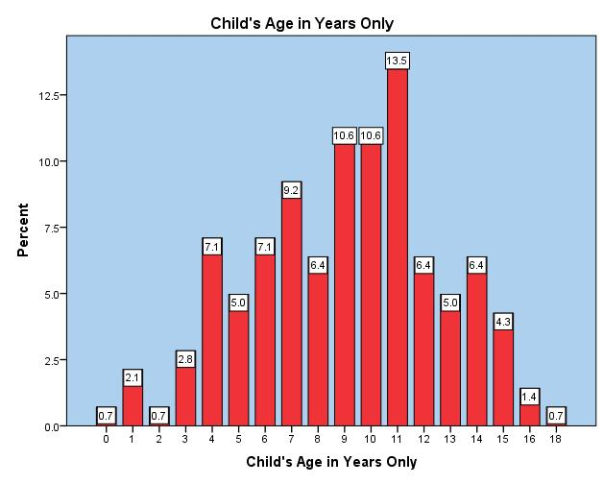
Initial Findings
______________________________________________________________________________________________________
2. Age
(n=141)

Slide 13
Initial Findings
______________________________________________________________________________________________________
3. Professionals
(n= 92)
Professional Making Referral | Percentage %
Head Teachers (Acting, Dep., Assist.) | 51.0%
Unknown roles | 19.5%
Teachers (Class/Form/Tutor) | 11.9%
Education Welfare Officers | 4.3%
School Nurses | 4.3%
Behaviour Support Managers | 2.1%
Child Protection Officers (Lead, Teacher) | 1.0%

Slide 14
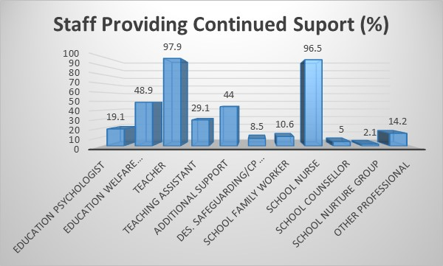
Initial Findings
______________________________________________________________________________________________________
4. Ongoing Support
(n=141)

Slide 15
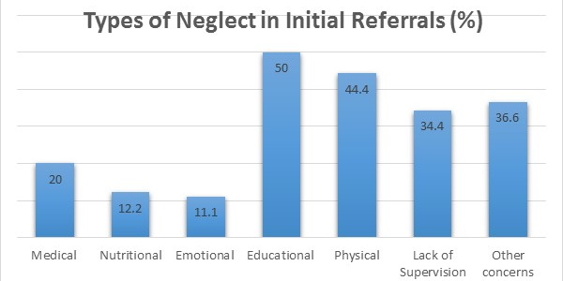
Initial Findings
______________________________________________________________________________________________________
5. Identification of Neglect
(n=90)

Slide 16
Initial Findings
______________________________________________________________________________________________________
6. Early Support
(n=58)
Type of Early Support | %
Practical Support | 46.6%
Referrals/Signposting | 34.5%
Emotional Support | 20.7%
Provision of Clothing | 19.0%
Provision of Food | 16.0%
Other | 5.2%
Financial | 0.0%

Slide 17
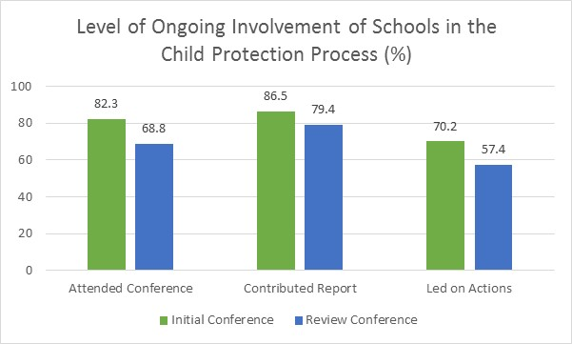
Initial Findings
______________________________________________________________________________________________________
7. Continued Support
Variable | % (Miss)
Attended Initial (n=131) | 82.3% (7.1%)
Attended Review (n=110) | 68.8% (7.1%)
Contribute Report Initial (n=127) | 86.5% (9.9%)
Contribute Report Review (n=129) | 79.4% (7.8%)
Led on Actions – Initial (n=130) | 70.2% (8.5%)
Led on Actions – Review (n=120) | 57.4% (14.2%)

Slide 18
(1) Summary of Findings
______________________________________________________________________________________________________
Within this sample, Primary Schools were the most common referrers (71.7%) compared to secondary schools (28.3%)
Head Teachers made the most referrals to Social Services (51.0%), followed by teachers (11.9%). Education Welfare Officers (4.3%), School Nurses (4.3%), and Behaviour Support Managers (2.1%)
Teachers (97.9%) and School Nurses (96.5%) were involved in providing ongoing support to the child throughout intervention. Education Welfare Officers were involved with 48.9% of cases.
44% of children were receiving additional support within the school in some form, with 29.1% receiving support from a Teaching Assistant and 19.1% from an Educational Psychologist

Slide 19
(2) Summary of Findings
______________________________________________________________________________________________________
The most frequently identified types of neglect by schools was Educational (50%), followed by Physical (44.4%), and Lack of Parental Supervision or Guidance (34.4%)
In 41.1% of cases schools had implemented early help and support prior to making a referral to Social Services. Of these cases, 46.7% consisted of practical support, 34.5% signposting or referring to an outside agency, 20.7% emotional support, 19% Provision of clothing and 16% food
In terms of ongoing support, there was a marked decline when comparing the Initial Child Protection Conference and the Review Conference. Attendance of schools at the meetings dropped (13.5%), the contribution of a reports to Social Services dropped (6.6%) and the amount of schools that continued to lead on action points on the child’s plan also dropped (12.8%)

Slide 20
References
______________________________________________________________________________________________________
Atkinson, P and Coffey, A. (1997) ‘Analysing documentary realities’ in Silverman, D. (Editor) Qualitative Research: Theory, Method, Practice. London: Sage. pp 44-62.
Bryman, A. (2001) Social Research Methods. Oxford: Oxford University Press.
Farmer, E. & Lutman, E. (2012) Effective Working with Neglected Children and Their Families: Linking Interventions to Long Term Outcomes. London: Jessica Kingsley Publishers
Floersch , J. (2000). ‘Reading the Case Record: The oral and written narratives of Social Workers’. Social Service Review. 74 (2) pp 169-192.
Field, A. (2013) Discovering Statistics using IBM SPSS Statistics. (Fourth Edition. London: Sage Publications.
Gorad, S. and Taylor, C. (2004) Combining Methods in Educational and Social Research: (conducting educational research). Glasgow: Bell & Brain Ltd.
Hayes, D. and Devaney, J. (2004) ‘Accessing Social Work Case Files for Research Purposes’: some issues and problems. Qualitative Social Work. 3 (3) pp 313-333.
Legislation.Gov (Online) ‘The Social Services and Wellbeing (Wales) Act (2014) [Available at] http://www.legislation.gov.uk/anaw/2014/4/pdfs/anaw_20140004_en.pdf
May, T. (2011) ‘Documentary Research: excavations and evidence’ in Social Research: Issues, Methods and Processes. (Fourth Edition) Maidenhead: Open University Press.
Prior, L (2003) Using Documents in Social Research. London: Sage.
Radford, L. corral. S. Bradley, C. fisher, H. (2013) ‘The prevalence and impact of child maltreatment and other types of victimization in the UK: findings from a population survey of caregivers, children and young people and young adults’. Child Abuse Review 37 (10)pp 801-831
Shaw, I. and Holland, S. (2014) ‘Traces and Deposits in Texts and Documents’ in Doing Qualitative Research in Social Work. pp 166-181. London: Sage Publications Ltd.
Statistics Wales (2014) (Online) Local Authority Child Protection Registers. Wales 2014. [Available at] http://gov.wales/statistics-and-research/local-authority-child-protection-registers/?lang=en
Welsh Government (2015) (Online) Keeping Learners Safe: The role of local authorities, governing bodies and proprietors of independent schools under the Education Act 2002’. [Available at] http://gov.wales/docs/dcells/publications/150114-keeping-learners-safe.pdf

Slide 21
Victoria Sharley
Doctoral Student
School of Social Sciences
Cardiff University
Thank you.
sharleyva@cardiff.ac.uk

Slide 22
Research Questions
______________________________________________________________________________________________________
Phase 2
What is the nature of education staff’s interdisciplinary interactions and communications with other professionals?
To what extent are education staff involved in the processes of identifying and responding to child neglect? (a) internal agency responses (b) multi-agency responses
What are the staff’s understandings and constructions of child neglect?
What are staff’s role perceptions in terms of their responsibility to respond to neglect?
What are the education staff’s experiences of receiving professional guidance and support from designated colleagues within the school?
What are the characteristics of the relationship between the staff member, the child, and the child’s parents, and how do these change following the referral?

