Slide 1
Governor training Looked After Children
Wednesday 27th April 2017
Gillian James Achievement Leader
Notes:
Introduction by Cllr Lent

Slide 2
Objectives
To have a clearer understanding of the background and needs of a Looked After Child
To understand our role as corporate parent
To learn about services that support Looked After Children in Cardiff
To learn how you can support your school to do their
best for Looked After Children
5. To take away personal learning and put into action
Notes:
MG

Slide 3
Some facts
5,755 children were looked after by Welsh local authorities at 31 March 2014
5,250 of these children were identified as white
In 2013 :
90% of children who are looked after aged 5 -15 are in mainstream schools
10% of children who are looked after aged 5 -15 are in special schools
13% who are looked after have a disability
66% of children who are LAC have some form of special educational needs (SEN)

Slide 4
There is a gap in educational outcomes of children that are looked after at every key stage
Stage | Pupils in Wales | Looked After Children
Foundation Phase | 83% | 53%
Key Stage 2 CSI | 84% | 53%
Key Stage 3 CSI | 77% | 36%
Key stage 4: 5 GCSEs at Grade A* -C in English or Welsh first Language and Mathematics | 53% | 13%

Slide 5
Comparative performance of Looked After Children
 | Cardiff LAC 2015 | Wales Children in need census 2015 | Cardiff LAC 2016 | Cardiff All Pupils 2016 | Cardiff LAC OOC
Foundation Phase Outcome Indicator | 75% | 64% | 89% | 88.9% | 50%
Key Stage 2 Core Subject Indicator | 56% | 64% | 68% | 89.5% | 75%
Key Stage 3 Core Subject Indicator | 38% | 48% | 47% | 87% | 63%
Key Stage 4 Level 2+ Threshold | 17.1% | 18% | 21% | 62% | 17%

Slide 6
Quiz
How many Looked After Children are there in Cardiff?
502
589
720
649
Notes:
MG

Slide 7
Quiz
How many looked After Children in Cardiff are educated out of county?
Approximately:
200
300
400
Notes:
MG

Slide 8
Quiz
Which answers match to which age range? 195; 139; 162; 0; 151
0 – 4 5 – 10 11 – 15 16 – 17 18+
Notes:
MG
0 39
1 29
2 34
3 23
4 26
5 28
6 27
7 26
8 31
9 28
10 22
11 28
12 34
13 41
14 41
15 51
16 67
17 72
18+ 0
0 – 4 151
5 – 10 162
11 – 15 195
16 – 17 139
18+ 0

Slide 9
Quiz
How many Looked After Children have a Disability?
9
20
35
41
Notes:
MG

Slide 10
Quiz
How many children and young people are unaccompanied asylum seekers?
0
5
10
15
Notes:
MG

Slide 11
How Many Looked After Children are from Ethnic Minorities?
Any other ethnic origin (please specify) | 18
Any other mixed background | 19
Asian - any other background | 10
Asian British | 5
Bangladeshi | 5
Black - other background | 5
Black African | 21
Black British | 0
Black Caribbean | 5
Chinese | 0
Gypsy Traveller | 0
Ethnic Groups / Any other ethnic origin (please specify) | 0
Indian | 5
Not stated | 23
NULL | 0
Pakistani | 15
Refused to disclose | 10
White - other background | 22
White and Asian | 11
White and Black African | 10
White and Black Caribbean | 19
White British | 438
White European | 12
White Irish | 0
Total | 654
Notes:
MG
Please see attached spreadsheet that shows distance from home as requested and breakdown of ethnicity, please note for the ethnicity breakdown I’ve rounded up or down to the nearest 5 any figures below 10, so no child can be identified, the effect of rounding off can be seen as the total shows 654 instead of 647 the actual total.

Slide 12
What is Corporate Parenting?
The “Official” Definition
Corporate Parenting is ‘The collective responsibility across services and across local authorities, to safeguard and promote the life chances of looked after children’
Notes:
MG

Slide 13
Activity
‘Voice of the child’ discussion:
Think of a child you know well – as a parent, what activities would you support that child in, every day, every week, every month?
What would you do to ensure your child has a happy and fulfilled life?
How do you know that you’re a good corporate parent?
If this were my child….
Notes:
MG
How might the needs change over time?
How would a parent react if a child gets into trouble or excels?
How would a parent prepare their teen for adulthood?

Slide 14
A Looked After Child’s Story

Slide 15
If this were my child…….
When you became a Governor you also became responsible for ensuring that the school acts as good ‘corporate parents’ for all the looked after children they have on role
The role of the corporate parent is to seek for children in public care the outcomes every good parent would want for their own children.
Notes:
MG

Slide 16
A Good Corporate Parent Means…
…doing more than fulfilling statutory duties
…doing your best for looked after children and care leavers in your school
…wanting your children and young people to be happy, healthy and safe from harm; to have positive experiences in your school
…helping children to enjoy themselves
Notes:
MG

Slide 17
A Good Corporate Parent Should…
…help young people to maximize their potential by providing or assisting in finding employment, higher and further education or apprenticeships
…ensure the provision for children and young people of secure, lasting and loving relationships
…act as a guardian
…take their corporate parenting responsibilities seriously
Notes:
MG

Slide 18
Corporate Parenting- Why is it important?
Every child and young person in Wales has rights as outlined by the UNCRC. These rights include:
Educational attainment (Article 29)
Participation (Article 12)
Confidence (Article 14)
Health (Article 24)
Wellbeing (Article 19)
Good corporate parenting will ensure that looked after children have the same access to their rights and ultimately the same life chances as other children in Wales.
Notes:
MG

Slide 19
Activity
‘Experience of the child’
Think of examples of why a child or young person might become looked after?
Notes:
Death of a parent
Abandonment
Abuse and neglect
Beyond parental control
What is a looked after child? - as you can understand, taking a child into care isnt something that’s done lightly, and an application for a CO is only made after attempts to support the family haven’t worked.
A CO lasts until a child reaches 18; until the court is satisfied that the child can return home; until adoption; or until a plan is made for the child to return home or with other family (RO or SGO)

Slide 20
Activity
How do you, and we, ensure only the children that need to be are those that are looked after?
Notes:
MG

Slide 21
Key documents/legislation
Towards a Stable Life and a Brighter Future – June 2007
Social Services and Well-being (Wales) Act 2014
Draft Additional Learning Need and Education Tribunal (Wales) Bill
Raising the ambitions and educational attainment of children who are looked after (Jan 2016)

Slide 22
Key messages from Young People in Cardiff:
Young people want to be consulted and want their opinions to be considered.
Contact is a key issue for young people, and they need to understand the reasons behind agreed contact arrangements (e.g. when contact is supervised / frequency of contact).
Young people do not like the acronym “LAC” as it suggests they are lacking something.
The Pathway Plan is an important document.
Notes:
MG In relation to this Director’s Report, the Director and senior managers, alongside members of the Corporate Parenting Advisory Committee, engaged in a face to face challenge session with young people based upon their own analysis of the report. This was a positive and mutually beneficial experience and some of the key messages emerging from young people were:
What does a young person expect from a corporate parent?

Slide 23
The When I’m Ready scheme has three main objectives:
provide stability and continuity for young people leaving foster care as they prepare for independence
improve the life-chances of our Looked After Children
ensure Looked After Children and Care Leavers can exercise their voice and have control over the decisions that affect their lives.
Notes:
MG/DMJ
The When I’m Ready arrangement extends until:
The young person first leaves the WIR arrangement, or
The young person reaches their 21st birthday if continuously living in the arrangement or;
The young person completes their agreed programme of education or training after their 21st birthday, if continuously living in the arrangement since their 18th birthday.

Slide 24
Corporate Parenting Strategy
Aim - We want children and young people in our care to have the best possible life experiences, to be safe, happy and healthy, and achieve their full potential at school and in the future. We want to do this in collaboration with our partner agencies and where possible with families. And where it is safe to do so, we want children to remain at home with their parents or extended families with effective support services.
Notes:
IA lead discussion and state that strategy is to be considered/agreed at business meeting following this workshop
Launch planned for 21st October of this and the Early Help Strategy

Slide 25
For good outcomes for looked after children to be achieved and costs controlled in the long term it is essential that a long term strategic approach is maintained.
Development of more integrated and effective preventative services is needed to ensure that children do not become looked after unnecessarily and, when they do become looked after, to reunite them with their families successfully wherever possible.
Preventative services must take a whole family approach and assess health, education, housing and social care needs in order to improve outcomes and avoid escalating costs.
Notes:
IA…rather than making short term decisions which will create increasing budgetary pressures in future years.

Slide 26
Raising the ambitions and educational attainment of children who are looked after in Wales

Slide 27
‘There is clear evidence that the education system is failing to support children who are looked after effectively’
‘There has been progress in supporting children who are looked after to reach their academic potential, but the impact has been marginal and the pace of improvement has been too slow’

Slide 28
WG framework for future action:
raise the educational aspirations and attainment of children who are looked after and the ability of those who care for them to support their educational development
reinforce the collective accountability and effective leadership across the WG, local authorities, schools, further and higher education institutions for the educational outcomes of children who are looked after
make education apriority and a point of focus, especially during the periods of upheaval and uncertainty that can happen in the life of children who are looked after
identify data that will aid practice, policy making and monitoring of educational outcomes
ensure excellent practice is identified, promoted and shared where it exists

Slide 29
‘We must work towards these objectives with urgency. Another year cannot pass where systems and structures we have put in place allows for a single looked after child to have an unsatisfactory educational experience and miss out on opportunities to fulfil their true potential’

Slide 30
Defining attainment
Using a number of common measures:
Level 2 inclusive (L2inc) refers to the achievement of a volume of qualifications equivalent to 5 GCSEs at grade A* to C including English or Welsh First Language and Mathematics
Core Subject Indicator (CSI) refers to the achievement of the expected level in each English or Welsh Language, Mathematics and Science at the end of a key stage
The expected level at the end of:
Foundation Phase is Foundation Phase Outcome 5
Key Stage 2 is National Curriculum Level 4
Key Stage 3 is National Curriculum Level 5

Slide 31
‘ensure that the learner’s progress is properly tracked , so that interventions are quickly applied where attainment appears to be in decline’
So in Cardiff we have set up a virtual school and our aim is to:
Track pupils on a termly basis
In partnership with schools identify underachievement, identify the barrier to underachievement and ensure intervention /s recorded and progress is made

Slide 32
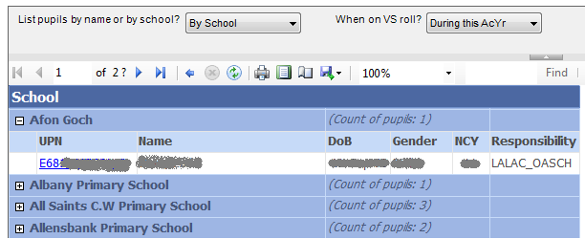
VS Register

Slide 33
Pupil Information Sheet

Slide 34
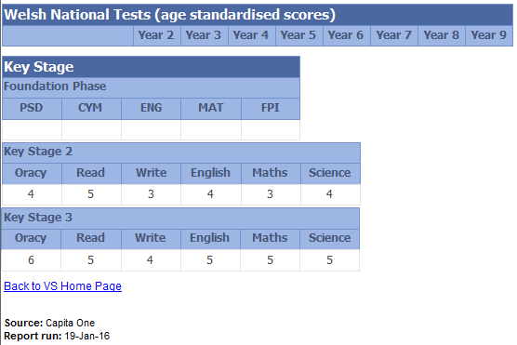

Slide 35
The Children Act 2004 (Section 52) places a positive duty on responsible authorities to promote the educational achievement of Looked After Children :
Appoint Looked After Education Co-ordinators
Every child should have a high quality Personal Education Plan (PEP)

Slide 36
The LACE team based in Education

Slide 37
Personal Education Plans (PEPs)
Wherever the child is place, his/her social worker MUST take the lead to:
- initiate a PEP, as part of the Care Plan, irrespective of whether the child has a school place or not

Slide 38
What is a PEP?
‘ A tool to support personalised learning of the child reflecting educational needs/ views and ambitions’
Sets clear goals or targets relating to their achievements, out of school activities and personal/behavioural targets
MUST involve the child, parent and /or family member and carer
Completed in partnership with key people in the child’s life

Slide 39
And……..
Is an achievement record
Includes a history of educational placements
Is linked to other education plans e.g. Individual Education Plans (IEPs)
Identifies additional needs, e.g. developmental, educational, behavioural and emotional needs
Records short and long term targets
Identifies the support required and how it will be provided

Slide 40
And …….
Identifies and plans for transitions in particular movement to higher education, employment and training
Considers out of school life and engagement in positive activities
Monitors attendance

Slide 41
What makes a good PEP?
Listens to the voice of the child
Timely
Detailed
Contains all requested data
Clear, relevant but achievable goals
Linked to notes recorded in the PEP
Takes account of views of all key people e.g. foster carer, school staff, social worker and other key professionals
Is holistic
Plans and records the aspirations for the child’s future

Slide 42
What does good provision in school look like for Looked After Children look like?

Slide 43
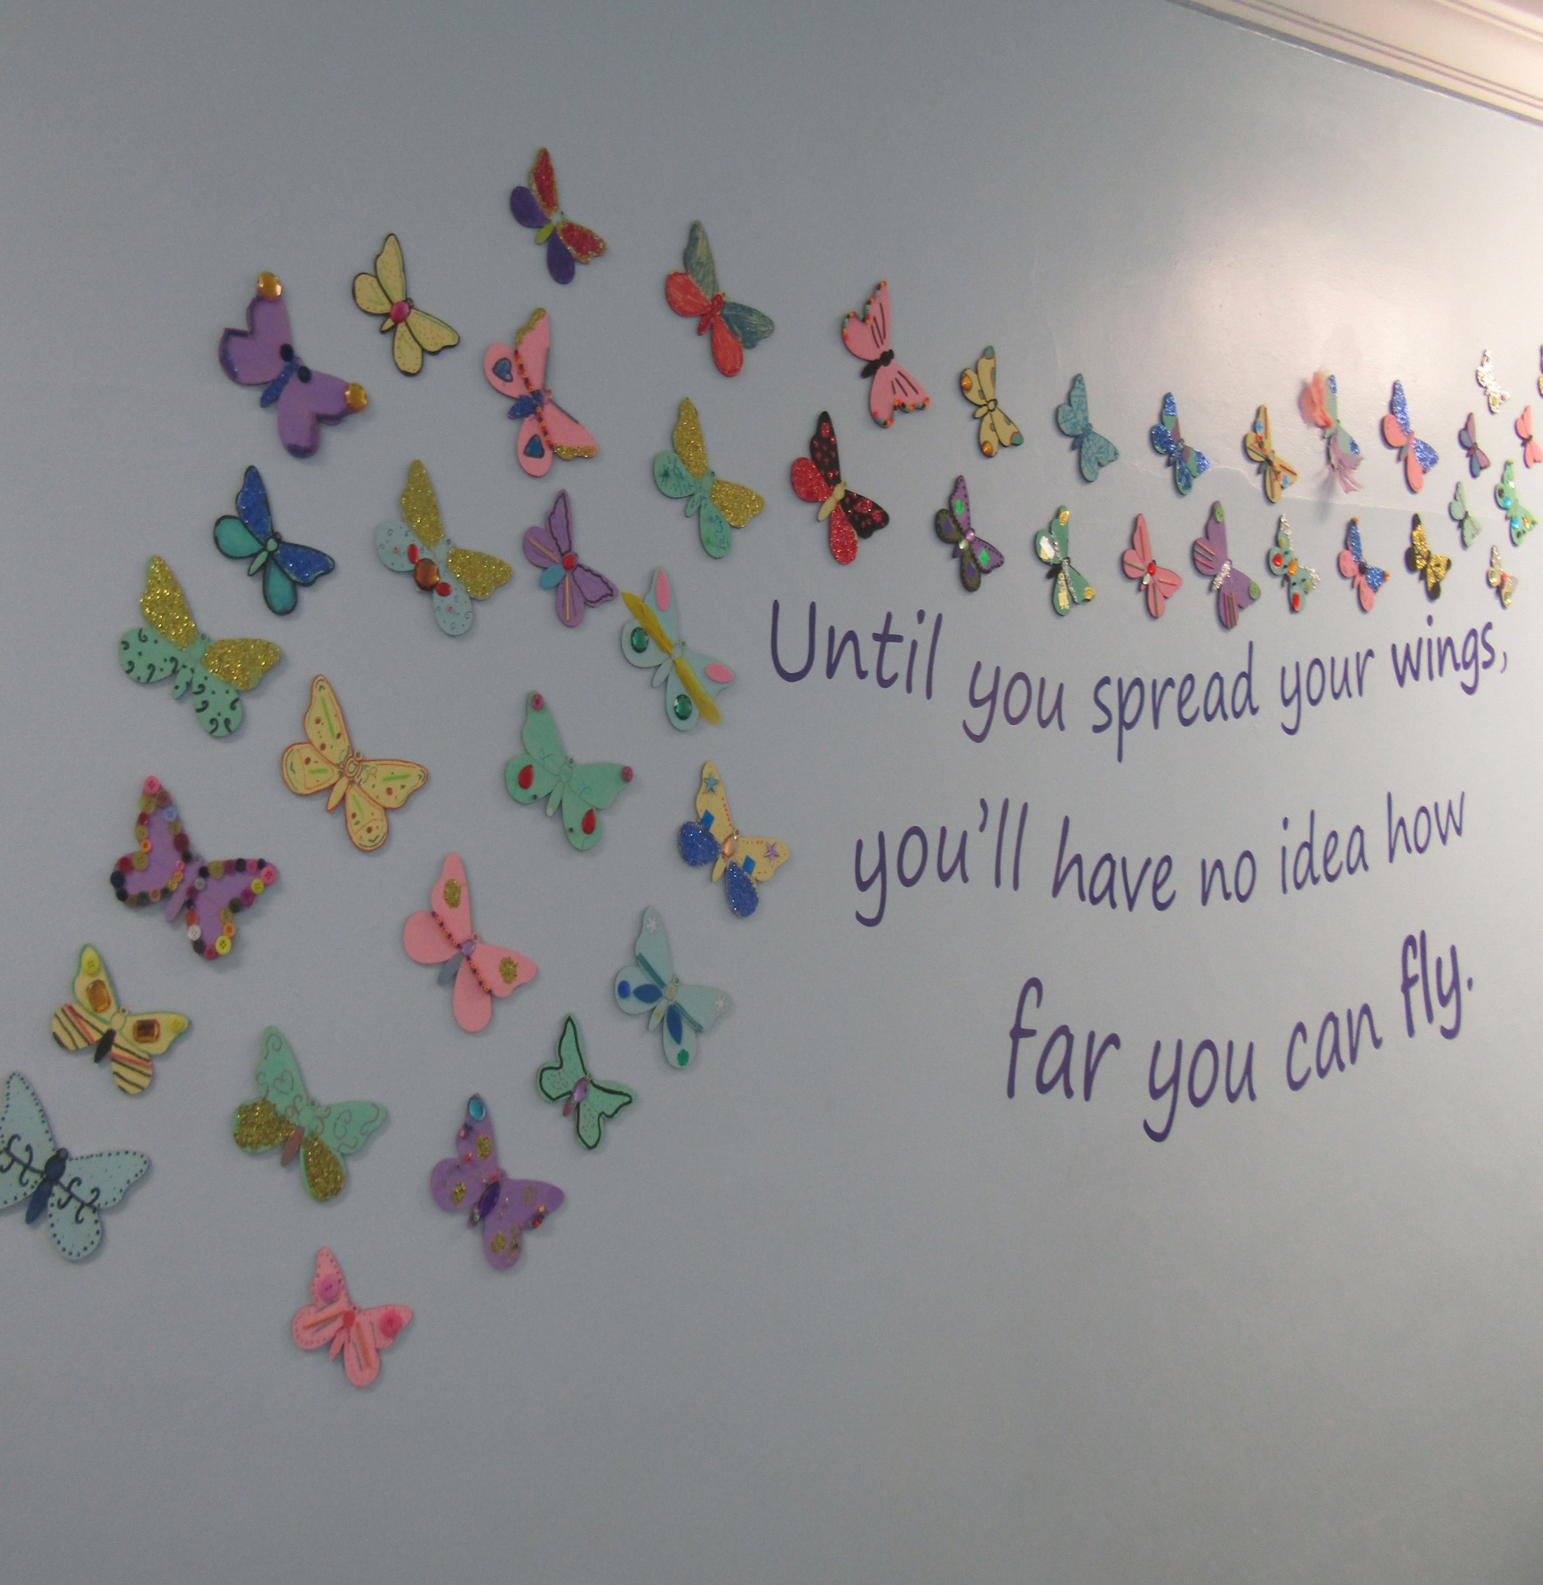
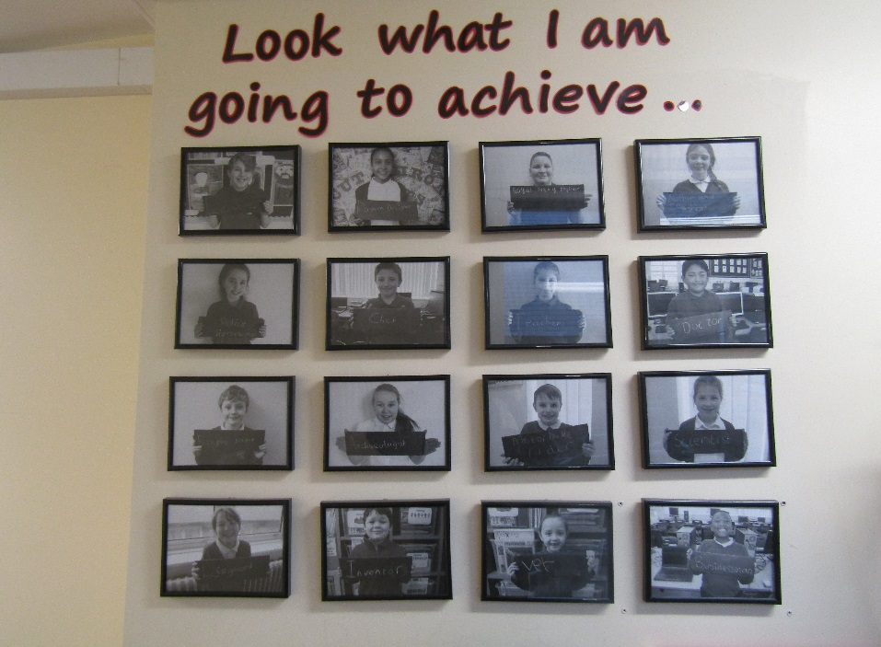
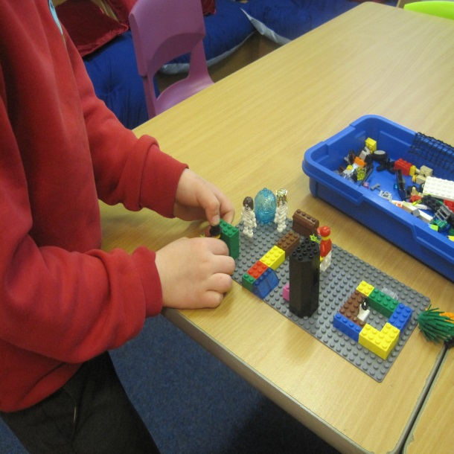
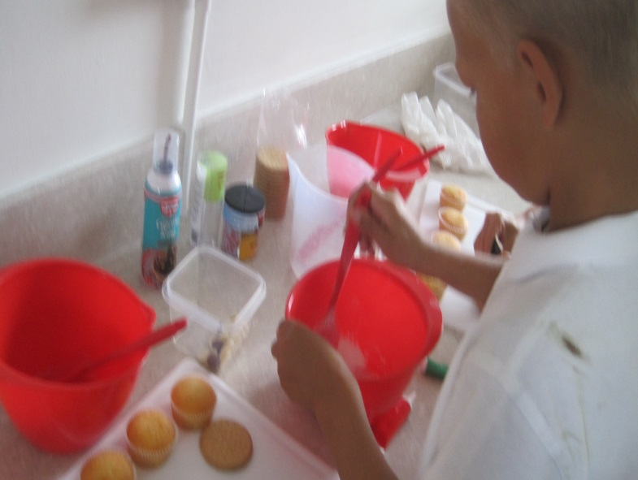
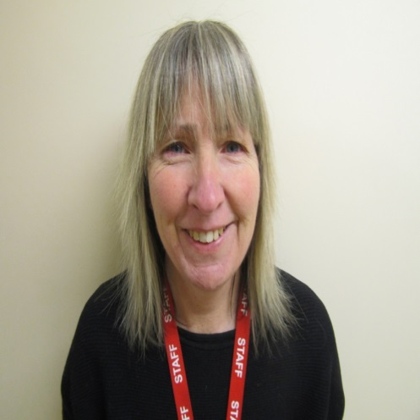
Build to Express
Cookery Therapy
Mrs Smith

Slide 44
Some questions to answer as a governor
Who is the Looked After Children’s designated teacher in your school?
Is the LAC designated teacher tracking, monitoring and challenging where necessary the progress of Looked After pupils?
What has your school got in place to consider the well being of Looked After pupils?
Is there a designated governor for Looked After Children on the governing body?
Is the designated teacher reporting the progress of Looked After pupils on a regular basis?

Slide 45
What additional support and intervention is in place for the LAC pupils in the school?
Are the attendance and any exclusions of the Looked After pupils being monitored?
Are the views of the Looked After pupils sought, valued and used to inform appropriate provision?
Is the school involving, communicating and working in partnership with the foster carers or children’s home?
Are the Personal Education Plans (PEPs) up to date and of good quality?
Is the governing body challenging under-performance of Looked After pupils?
Has the governing body accessed training to understand fully their responsibilities in working with this vulnerable group of young people?

Slide 46
Two things to take away
Remember we all need to go the ‘extra mile’ for Looked After Children in our schools
As a governor you can be a ‘champion’ of Looked After pupils in your school to ensure that they get the best possible school experience

Slide 47
Consider 3 things you will do following on from today’s workshop
Notes:
IA

Slide 48
Thank you for listening
Debbie Martin- Jones DMartinJones@cardiff.gov.uk
Gillian James - GillJames@Cardiff.gov.uk

