Slide 1
Approaches to system working – learning from system engagement events
Dr Amrita Jesurasa, Acting Consultant in Public Health
First 1000 Days Programme
19 March 2019
Slides adapted from those produced by:
Dr Julie Bishop
Director of Health Improvement
Public Health Wales

Slide 2
Overview
Systems working in public health theoretical perspectives from obesity
Learning from systems working events in First 1000 Days
Approaches to system working

Slide 3
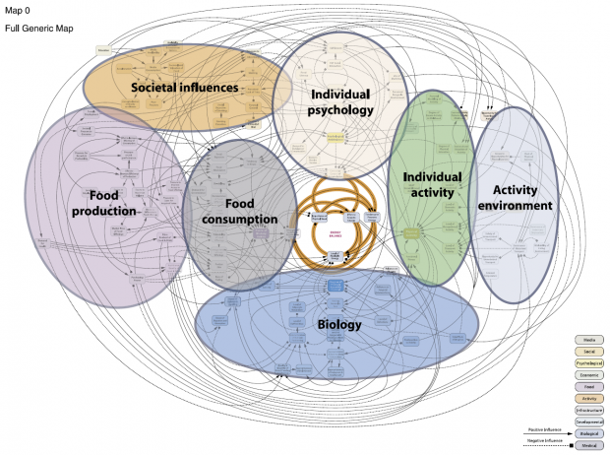
Why systems Working is Important
Approaches to system working
Notes:
Obesity isn’t caused by a single factor but emerges from a complex system of distinct and interconnecting factors such as those identified in the Obesity Systems map

Slide 4
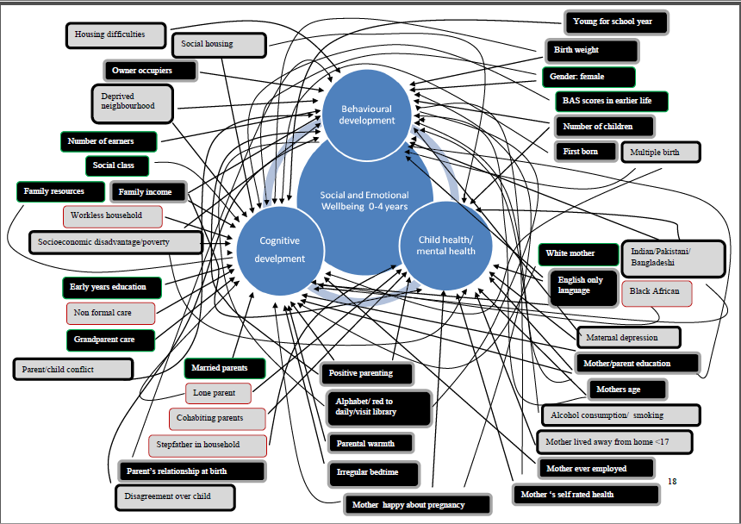
Approaches to system working
Notes:
Similarly this diagram depicts risk factors significantly associated with child wellbeing, produced by a team at the University of Sheffield to directly feed into the NICE guideline on social and emotional wellbeing in children age 0-4

Slide 5
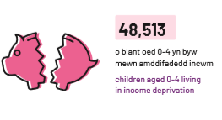
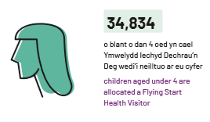
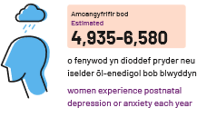

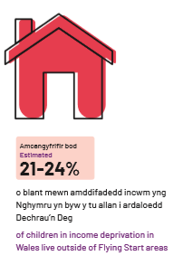
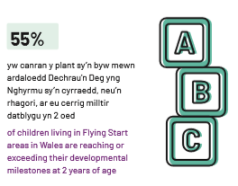
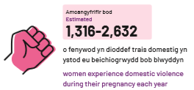
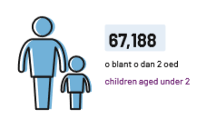
Complex system of factors affecting child wellbeing in Wales
children aged 0-4 living in income deprivation
children aged under 4 are allocated a Flying Start Health Visitor
women experience postnatal anxiety or depression each year
live births per year
of children living in Flying Start areas in Wales are reaching or exceeding their developmental milestones at 2 years of age
women experience domestic violence during their pregnancy each year
children aged under 2
of children in income deprivation in Wales live outside of Flying Start areas
Approaches to system working

Slide 6
Key Concepts and Components of System Approaches (Adapted from Garside et al, 2010)
facilitative leadership
learning and adaptation
capacity building
encouragement of local creativity and/or innovation
developing working relationships
enhancing communication
community engagement
explicit recognition of the (public health) system
embeddedness of policy and action
robustness and sustainability
Ruth Garside, Mark Pearson, Harriet Hunt; Tiffany Moxham,; Rob Anderson, PenTAG
https://www.nice.org.uk/guidance/ph42/evidence/review-1-identifying-the-key-elements-and-interactions-of-a-whole-system-approach-to-obesity-prevention-69056029
Approaches to system working

Slide 7

Identification of the system; with the system and sense of purpose
Sense of common ground but not of being part of a system
Some groups with something to offer did not feel included in the system
No clear sense of collective purpose
No sense of alignment around a common set of goals
Time to explore is needed – pressure to show quick wins or outcomes is counter productive
Approaches to system working

Slide 8
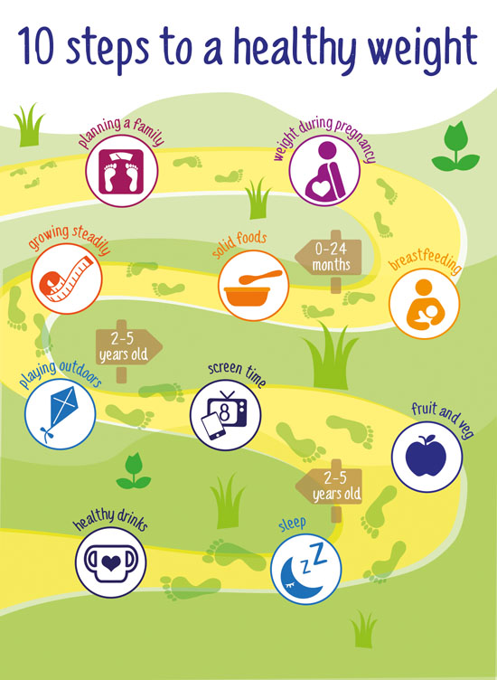
Designing purpose and outcomes at a system level
Avoid ‘motherhood and apple pie objectives and outcomes’
Need to unpack outcomes
Systems within systems
All actors may not be aligned to the overarching purpose
Approaches to system working

Slide 9
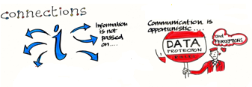
Relationships and Communication
Relationships are accidental or between individuals
Little evidence of purposeful relationship building as a desirable outcome
Sense that time spent with others would be seen as a ‘waste of time’
No evidence of system-wide communication mechanisms
Creating spaces for purposeful dialogue
Approaches to system working

Slide 10
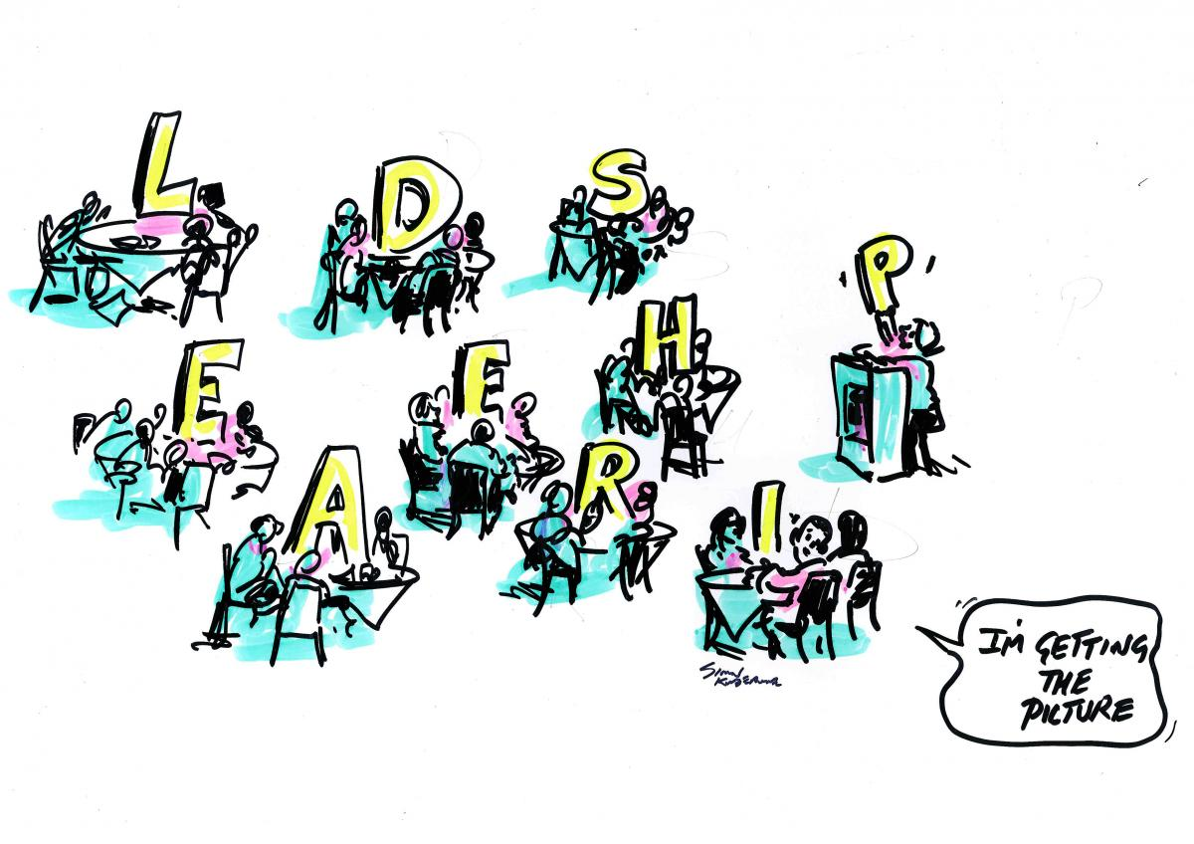
Leadership
Little evidence yet of leadership or responsibility over the system or to facilitate the system to work in most areas
Distributed leadership?
Senior leaders not engaged directly in most cases
NHS leadership role lacking
No collective accountability
Approaches to system working

Slide 11
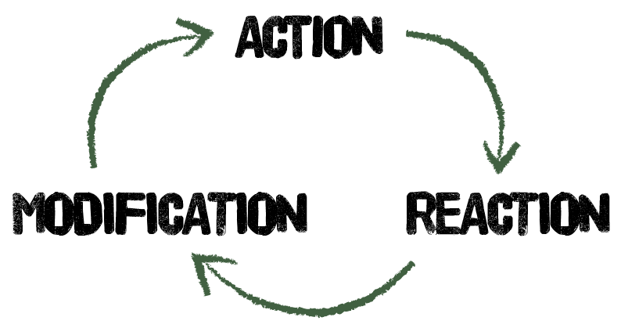
Learning and adaptation
Confusion over outcomes and indicators
Lack of common accountability mechanisms
Limited or poor use of data to drive self evaluation, adjustment, self correction of the system
‘Real time feedback’ very challenging
Approaches to system working

Slide 12
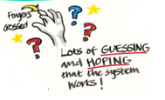
Creativity and Innovation
High level of innovation – people like their own ideas
‘it won’t work here…..’
Innovation without measurement or evaluation
Creativity and innovation not necessarily driven by desire to improve outcomes
Little evidence of understanding what the system already knows
Approaches to system working

Slide 13
Level | Definition/Description | Evaluation Objective
Structural elements | Subsystems, actors, and the physical structure of the system | Assess level of coherence among the components of the system
Feedback and delays | Self-regulation, self-reinforcement, and adaptation of the system. Reinforcing loops for driving growth and balancing loops for constraining goals | Assess degree to which the system operates in a continuous manner, and assess the likelihood that the system will or will not grow
Structure | Enhancing connections across most of the system as a whole | Assess degree to which interdependent elements in a network work together
Goals | What the system is trying to achieve | Evaluate how well the system adapts to its environment
Paradigm | A system's deepest belief | Understand the degree to which the system acts as a learning environment
Places to Intervene in a Complex System and the Associated Evaluation Objectives. SOURCES: Adapted from Finegood, 2011; Malhi et al., 2009; and Meadows, 2008.
From: 9, Systems and Evaluation: Placing a Systems Approach in Context
Evaluating Obesity Prevention Efforts: A Plan for Measuring Progress. Committee on Evaluating Progress of Obesity Prevention Effort; Food and Nutrition Board; Institute of Medicine; Green LW, Sim L, Breiner H, editors Washington (DC): National Academies Press (US); 2013 Dec 11. Copyright 2013 by the National Academy of Sciences. All rights reserved. NCBI Bookshelf. A service of the National Library of Medicine, National Institutes of Health
Approaches to system working

Slide 14


Unintended Consequences
System drivers for efficiency and modernisation working against desired ways of working
Process emphasis and standardisation – tick box culture
Approaches to system working

