Slide 1



Early Years Integration
Ceredigion & Carmarthenshire
Hywel Dda Footprint
November 2019
Noeline Thomas, Rhian Rees, Liz Wilson
NoThomas@carmarthenshire.gov.uk
Rhian.Rees@Ceredigion.gov.uk
Liz.Vi.Wilson@wales.nhs.uk

Slide 2
Progress

Slide 3
Health Authority Perspective
Transformation Bid:
1/8 programmes: Behaviour Change for Good
LA & Health Regional Partnership Bid
Provided a good foundation for the Early Years Pathfinder Business Justification Case
Enabled quicker ‘buy in’ from each organisation/service area

Slide 4
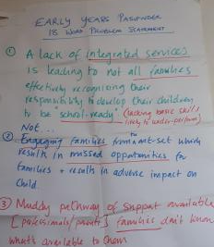
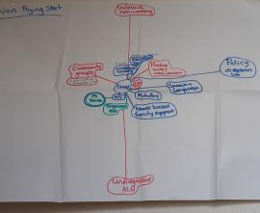
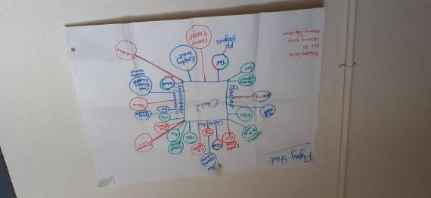
Carmarthenshire
Pilot
Operational Group
  Transformation, Innovation and Change Team (TIC)
  Mapping, Gapping, Visioning, Prioritising
  IT Systems Support/Research
3 Broad aims
Replicating the Flying start model universally
Strengthening engagement within the antenatal/post natal period
Improving the transition from Childcare to Education

Slide 5
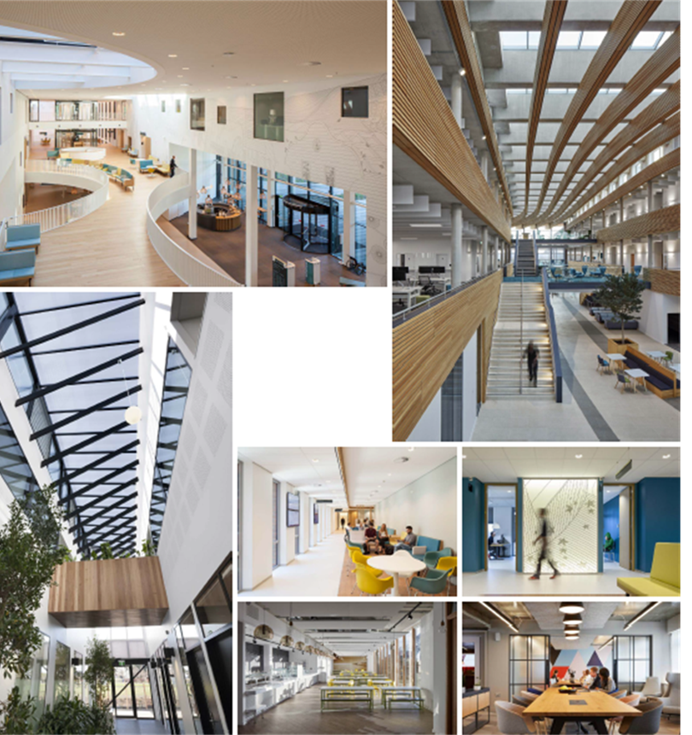
Early Years Integration Team
Cross Hands
Why Cross Hands?:
Health and Wellbeing Centre Development
No FS Provision
HV Caseload 1057 (compared to1832 FS)
We will:
Co locate services
Add Capacity to Universal Staff
Employ 4xFamily Support Workers and a Community Connector

Slide 6
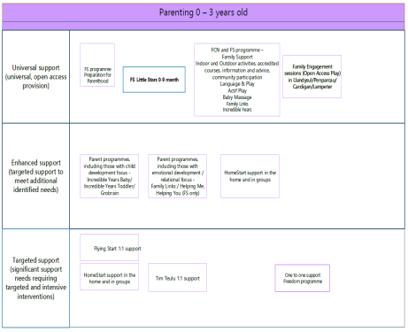
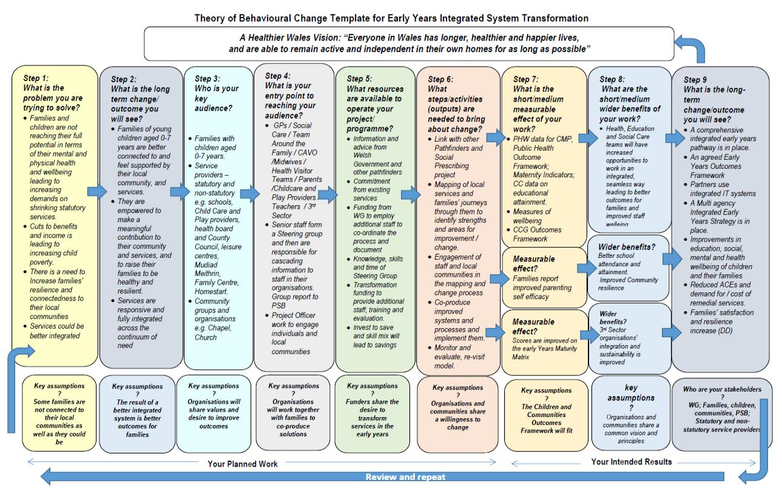
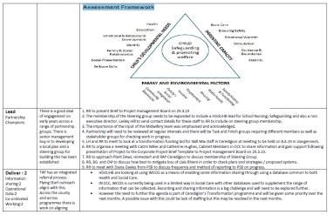
Ceredigion
Pilot
Operational Group
  Early Years Maturity Matrix,
  April 2019
  Visio Mapping, Gapping, Consulting Stakeholders, Visioning, Gathering Views
  Logic Model
  IT Officer Support
Broad aims
Strengthening engagement within the antenatal/post natal period
Ensuring that services across continuum of need are available across the Authority
Improving the transition from Childcare to Education

Slide 7
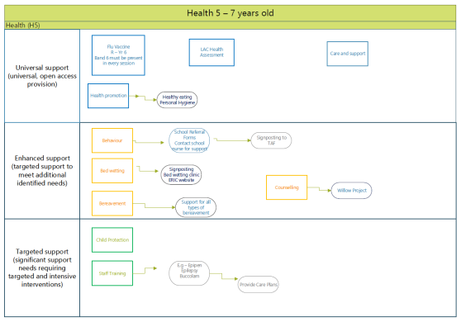
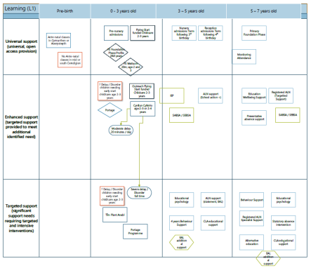
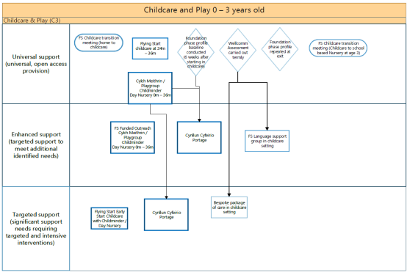

Slide 9
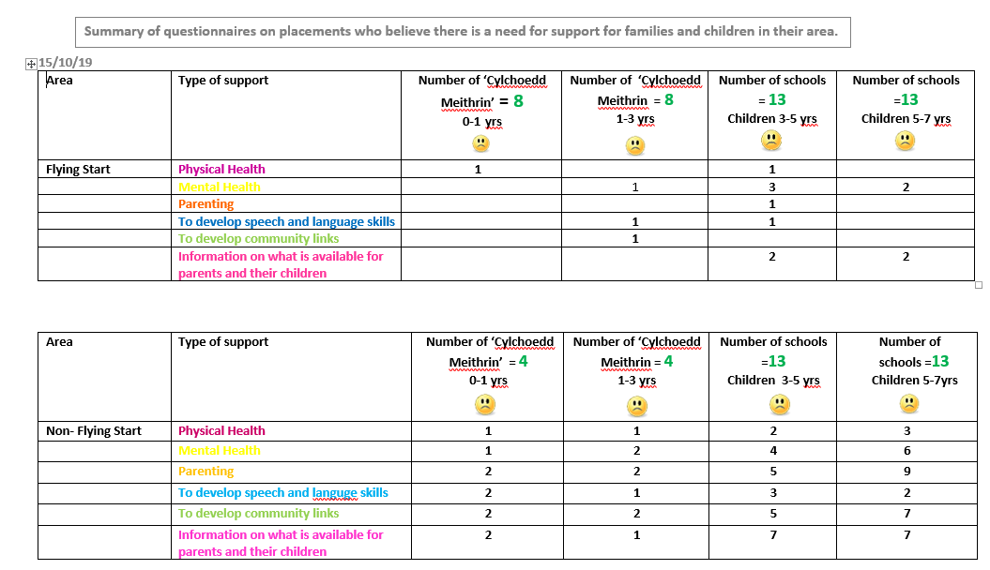
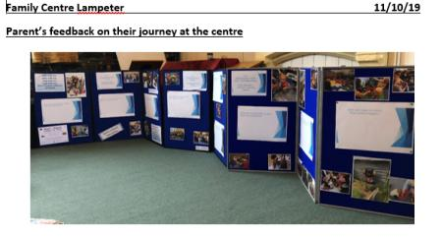
Beth ydyn ni’n poeni amdano? What are we worried about? | Beth sy’n gweithio’n dda? What’s working well? | Beth sydd angen digwydd? What needs to happen?
Cefnogaeth Iaith Cynnar a Siarad Support for Early Language and Talking Irregular courses Cefnogaeth Rhianta a Theuluol Parenting and Family Support Antenatal classes were difficult to find and attend Addysg Cynnar/Gofal plant/Cefnogaeth Dysgu Early Education/Childcare/Learning support No awareness, not enough information on Family Centres and facilities Cefnogaeth Iechyd Health Support No base for Health Visitor drop-in clinics | Cefnogaeth Iaith Cynnar a Siarad Support for Early Language and Talking Babbling babies Come and play Cefnogaeth Rhianta a Theuluol Parenting and Family Support Family Links was amazing. Built my/our confidence in interacting with my child. Addysg Cynnar/Gofal plant/Cefnogaeth Dysgu Early Education/Childcare/Learning support Interaction, sharing always talking to each other in the centre Cefnogaeth Iechyd Health Support Health Visitor very supportive | Cefnogaeth Iaith Cynnar a Siarad Support for Early Language and Talking Tiny talkers and Babbling Babies needed twice a year Cefnogaeth Rhianta a Theuluol Parenting and Family Support Crèche and parenting courses needed for school ready. Awareness and more understanding of bringing up children Chat groups/art and crafts sessions when you’re pregnant in order to socialise, communicate with other mothers to be. Addysg Cynnar/Gofal plant/Cefnogaeth Dysgu Early Education/Childcare/Learning support A course –Ready for School to make the transition easier. More courses on children with ALN First Aid Course Cefnogaeth Iechyd Health Support Midwife-regular sessions every 2 weeks Health Visitor drop-in –need the support Early support after the baby’s born Early support when pregnant

Slide 10
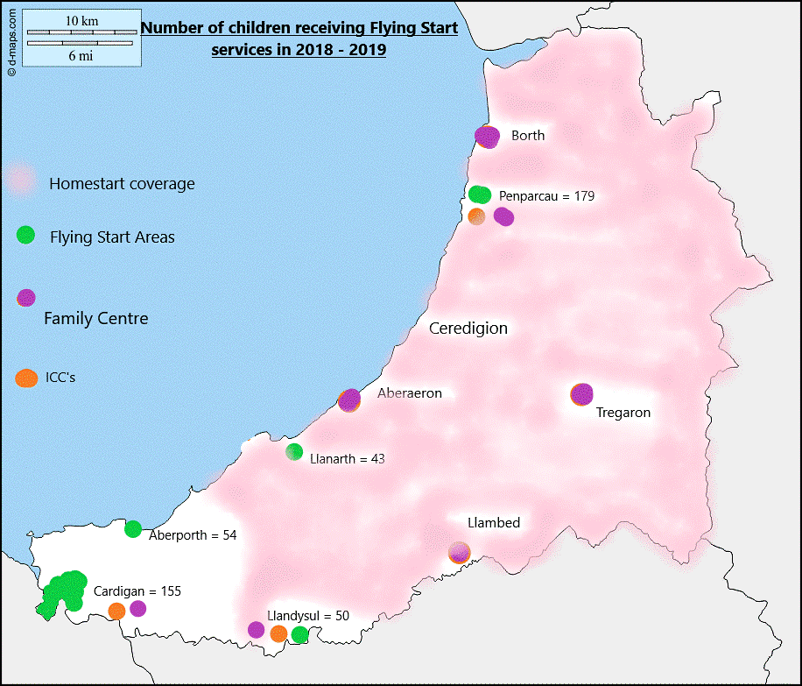
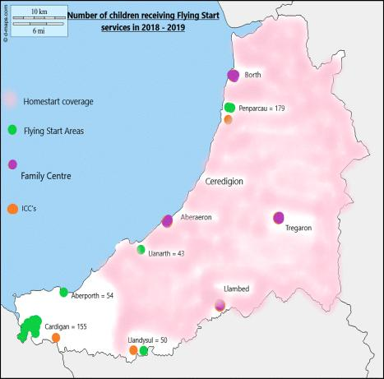
Pathfinder Pilot, Ceredigion
Map to areas with Family Centres in non FS areas
Already have good links with the community
Strong on skills, struggling with capacity to deliver range of support
Local HVs don’t have skill mix – delivery of HCW could be strengthened and enhanced
Utilise already existing staff structures

Slide 11
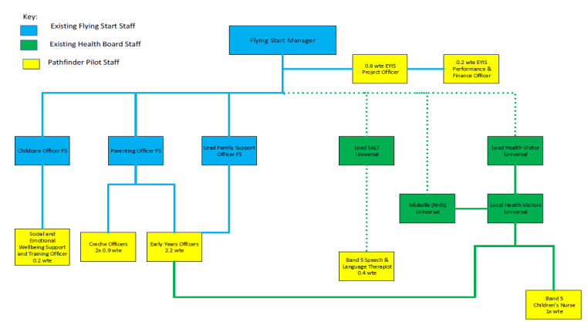
Strwythur Staffio Cynllun Peilot /
Staff Structure Pilot Project

