Slide 1


Cwm Taf Early Years Mapping
Geraint Evans
Service Planning and Transformation Manager
Rhondda Cynon Taf CBC

Slide 2
Overview
Strategic context
Aim of the exercise
The mapping exercise
Agreeing the parameters
Outcomes and benefits of the exercise
Summary and key messages

Slide 3
Strategic context
Prosperity for All “to create a truly joined-up, responsive system that puts the unique needs of each child at its heart”.
Early years co-construction project – December 2017
Objectives
To explore how early years services might be re-configured,
To explore what it will take to create an Early Years system locally,
To work together to deliver services in a co-ordinated, integrated and timely way,
Focussing on coordination of services, planning, commissioning and identifying and addressing needs,
To identify barriers to integration and remove them.

Slide 4
Aim
Public Service Board agreed a single integrated approach to early intervention is developed across Cwm Taf that:
focuses on the principles of building of resilience;
applies vulnerability profiling data to support the targeting of services;
delivers an integrated Early Years system through improved collaboration on approaches to TAF.

Slide 5
The Early Years mapping exercise
Cwm Taf

Slide 6
Starting point – Steering group
Parameters / criteria for the exercise;
Other factors for considerations (e.g. access criteria, age/location restrictions);
Information from across 2 local authorities and multiple organisations;
Method for collection and
Software to collate and present the information.

Slide 7
Three criteria and parameters
1 - Age
2 - Type of support
Pre birth
Health
All health related services for children 0-7 and their families.
0 – 3 years old
Learning
Services preparing children for school plus in school support.
3 – 5 years old
Childcare and play
Pre school childcare and support functions that wrap around educational provision
5 – 7 years old
Parenting
All services that support parents in their parenting role.
(Universal parenting framework)
Notes:
Define the subject / aim

Slide 8
3 - Level of need
FORMAL SUPPORT
Early intervention, targeted support to meet an identified need
INFORMAL SUPPORT
Universal, open access provision
SPECIALIST SUPPORT
Intensive intervention, significant support needs requiring targeted and intensive interventions
CHILDREN, YOUNG PEOPLE & FAMILIES

Slide 9
Collecting and collating
Highlight where the provision was provided (if restricted);
Summarise the information into the agreed parameters;
Could be presented to multiple stakeholders;
Had to support strategic and operational analysis.
Allow for the information to be used;
Was easily amended as and when required.
Microsoft Visio

Slide 10
The mapping document – 5 tiers
Structure

Slide 11
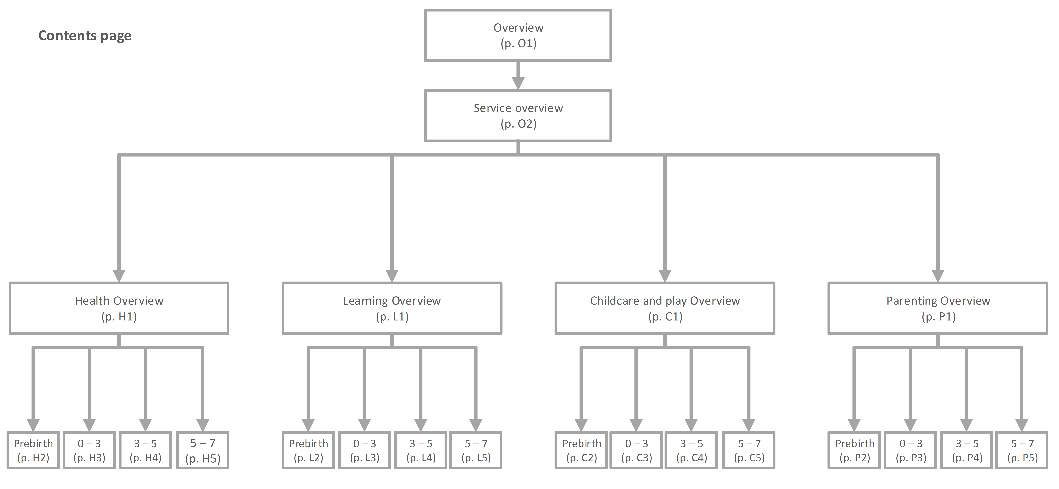
Mapping across Cwm Taf
STRUCTURE

Slide 12
The mapping document – 5 tiers
Map structure
Criteria map and overview of information

Slide 13
Overview of the information
Pre-birth
0-3 yrs
3-5 yrs
5-7 yrs
HEALTH
(All health related services for child aged 0-7 and families)
INFORMAL
LEARNING
(Includes services to prepare children for school plus in school support)
FORMAL
CHILDCARE AND PLAY
(Pre school childcare and support functions that wrap around educational provision)
SPECIALIST
PARENTING
(All services that support parents in their parenting role)

Slide 14
The mapping document – 5 tiers
Structure
Criteria map and overview of information
Service overview

Slide 16
Overview of the services mapped for:
3 – 5 year olds
Informal support
Health
Learning
Childcare and play
Parenting

Slide 17
The mapping document – 5 tiers
Structure
Criteria map and overview of information
Service overview
Breakdown by type of support

Slide 19
The mapping document – 5 tiers
Structure
Criteria map and overview of information
Service overview
Breakdown by type of support
Detailed breakdown

Slide 21
Mapping across Cwm Taf
STRUCTURE

Slide 22
Outcomes and benefits
Opportunity for collaborative working and to gain a shared vision.
Improved understanding of the breadth of services available to families.
Highlighted current gaps in provision.
Visual interpretation of key information.
Stimulated further discussion about what needed to change.

Slide 23
Summary and key messages
Start with what you have and build as you go along.
You could keep going.
It is not exhaustive and not all services would have been included.
The services included have not been quality assured.
Process of completing the exercise has been more valuable than the output.

Slide 24
Thank you
Any questions

