Slide 1
Early Years Integration Pathfinder
Gwent regional collaboration

Slide 2
Why regional?
Health Board footprint for 5 Local Authorities
What if we all want to make different changes? Could lead to more complexity??
Making the funding stretch further
Better for sharing wider practice
Better to test ideas and diversity of context
100% better for children and families
Made logical sense!

Slide 3
Steering group
Public Health Wales, Gwent
Aneurin Bevan Health Board
Newport City Council
Blaenau Gwent County Borough Council
Caerphilly County Borough Council

Slide 4
Regional approach
Shared aims, vision and objectives
Best for children and families
Better for workforce
All signed up for the unknown journey
Trust and honesty without blame – relationships are critical
Change management approach

Slide 5
Regional mapping
Regional stakeholder meeting – bigger than we thought
The three LA areas represented
Aim to map and present all the stuff in the system in a consistent manner
Energy and enthusiasm – ready for change

Slide 6
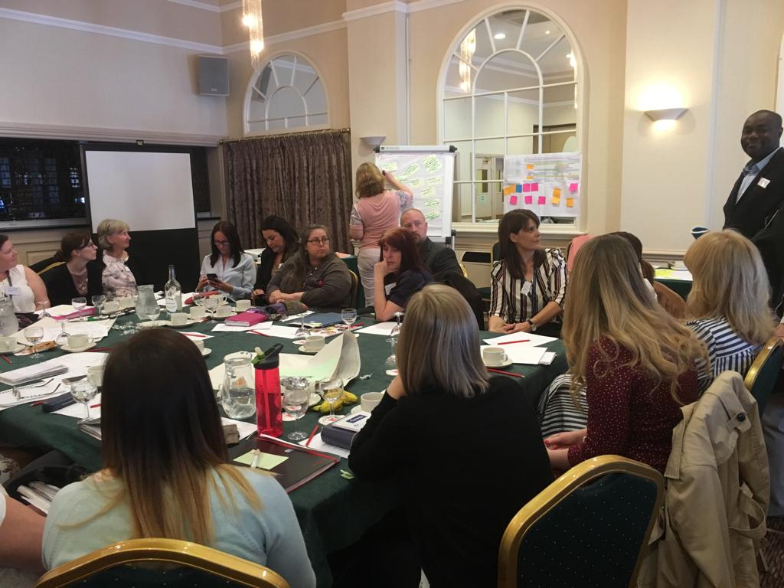
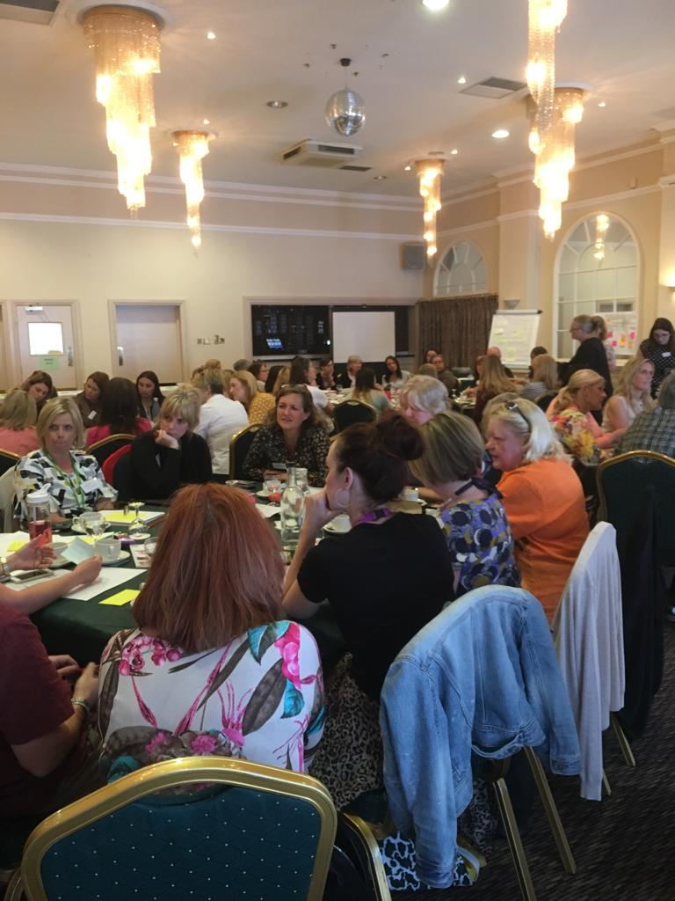
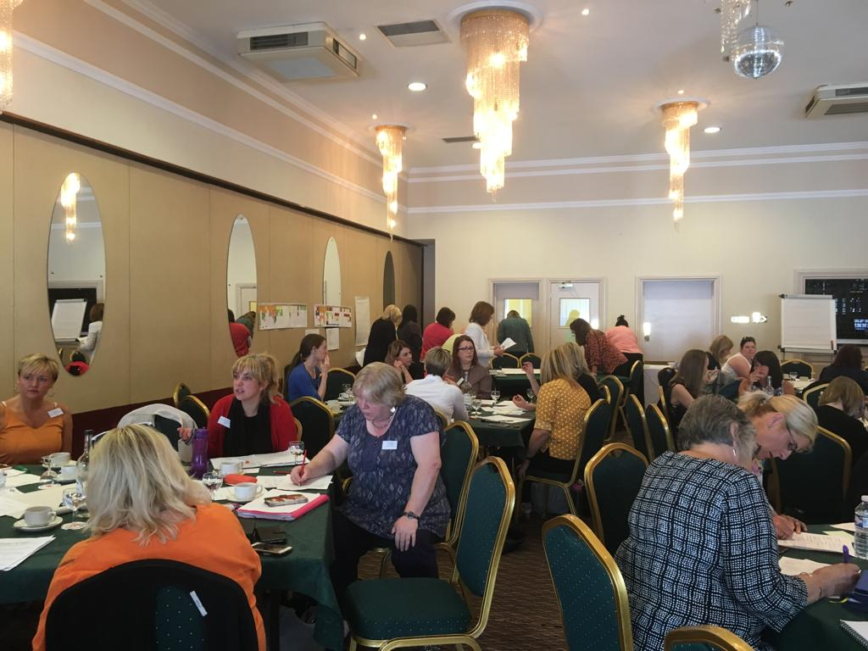

Slide 7
Maps
Same proforma
Excel maps with 4 tabs
  Antenatal – monthly
  Year 1 monthly
  Year 2 monthly
  Age 3-7 split 6 monthly
Categories
  Health
  Education / learning
  Family support / behaviour / parenting
  Childcare
  Housing
  Community groups
  Support re prison
  Money matters
  Drugs and alcohol
  Additional needs / child development
  Speech and language
  Mental health
  Employment

Slide 8
Capacity
Caerphilly recruited backfill to release internal post holder
Blaenau Gwent post advertised in August
Newport post gone to job evaluation
ABUHB released capacity for 2 day week post
Managers working together to drive forward

Slide 9
Van Guard - October
Senior managers – decision makers commitment
6 days intensive to
Understand the universal journey for a family
Understand the reality of the actual journey
Have the family tell their lived experiences
Find where things that could have been different
Analyse how we can make the system robust to prevent the anomalies
Draw the conclusions and plan the next steps needed

Slide 10
After Van Guard
Regional stakeholder group – November
Check system analysis work
Get the professional feedback and understand their needs
Check the conclusions and draft planned next steps from the Van Guard sessions – get clarity and check for any unintended consequences
Collate into full next steps plan
Take through governance system to plan future changes – Welsh Government, Public Service Board, Corporate teams in all LA and ABUHB
Implement changes!

