Slide 1
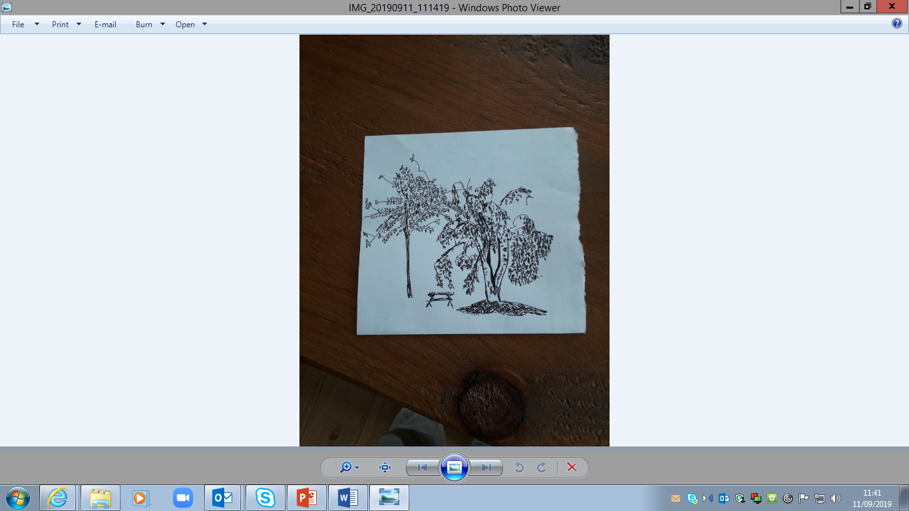
Flintshire Early Years PATHfinder
Integration and Transformation
Child-centred
September 2019
Gail Bennett
Early Years and Family Support Service Manager
gail.bennett@flintshire.gov.uk
kathy.williams@flintshire.gov.uk

Slide 2
Progress in Flintshire…..
Planning – Provision – Practice – Pooled Resources
June 2019
Coordinator Appointment
Governance
July 2019
Scope
Mapping
Early Help
Framework?
Maturity
Matrix
August 2019
Mapping
Key Stakeholders Stakeholder Management
NE/NW Wales Partnership
September 2019
Vision
Successes
Challenges
Mapping
Emerging Themes
Workforce
Where is transformative change needed?

Slide 3
Building a Joined Up and Responsive Early Years System
Key partners
Governance Structure (local, regional, national)
Five Ways of Working
Partnership Group:
  Public Health (Siobhan Adams; Rachel Lewis)
  Social Care (Craig Macleod; Gail Bennett)
  Health (Andrew Gralton; Polly Ferguson; Sarah Jones; Heather Chapman)
  Education
  Third Sector and Public Service Board (Ann Woods)
Grant Award

Slide 4
Flintshire Governance Structure - Early Years Pathfinder (Integration and Transformation)
WELSH GOVERNMENT
Well-being of Future Generations (Wales) Act 2015
Long Term - Prevention - Integration -Collaboration -
Involvement
PUBLIC SERVICE BOARD
PUBLIC SERVICE BOARD SUB-GROUP
HEALTH AND INDEPENDENT LIVING
Children’s Transformation Group (Partnership)
(Information)
FLINTSHIRE Early Years Pathfinder Steering Group (Integration and Transformation)
Representation from:
Public Service Board
Public Health Wales
Local Authority
Betsi Cadwaladr University Health Board
Third Sector Organisations
Stakeholder
Group
(Involvement; Participation;
Consultation)
GRANT AWARD
EXPRESSION OF INTEREST (Public Service Board approval)

Slide 5
Mapping
Creating a shared understanding
The Methodology
Informed choice for leaders within the Early Years System (partnership with Gwynedd)
What do we know? Challenging assumptions
Evidence and Research: First 1000 days
The Population
Services and the Workforce
Needs Assessment
Child; Family; Community
Multiple factors influencing a child’s progress

Slide 6
Developing the Vision – 9 September
To get it right for children, we need to get it right for families
  Facilitated Workshop – Partnership Group
  Current Strengths and Challenges of the Early Years System as it is today
  Short term quick wins and longer term priorities (12 months; 3 years)
  Secure good outcomes

Slide 7
Stakeholder Management
Set up for Success – a critical component
Where is transformative change needed?
Identify:
most influence
most affected
important people
top motivations and interests
Aug 2019
Stakeholder
Management Plan
Health
Education
Childcare
Social Care
Sept - Dec 2019
Careful planning
What do we want to know?
How will it make a difference?
Expectations
Risks
Opportunity
Jan – Mar 2020
Use every opportunity
Weighted hierarchy
Priorities

Slide 8
Quick Wins
What are we gifted to change; the family journey
Operational
SaLT: introduction of Family Information Service onto their service template. Ask the question.
SaLT: recruitment for a shared resource – discussions opened for 0-5 and 3-4 foundation phase (EYPDG)
Childcare: review of grant application process
Strategic
Ages 7+ align with Funding Flexibilities and other strategic aims
Increased understanding: roles, responsibilities; early years

Slide 9
Conversation Starters
Services that meet the needs of children and families
Robust systems: transfers; information; transitions; pathways/walkways; early help and SPOA’s
Infrastructure: information sharing and assessments
Transitions: 5+ HCWP2? Miller Report? School Nursing role, expansion, support
SLC: everybody’s business; roles and responsibilities
Mental Health: champions; information; personality disorder; perinatal mental health

Slide 10
Workforce
Sharing of knowledge and expertise. Equity and standardisation of training and delivery
Strong and Positive Families
  Attachment, Relationships, Parenting Support
  Understanding of child development, children’s needs and children's behaviour
Health and Wellbeing
  Brain development
  ACEs and trauma informed / resilience informed
  Speech, language and communication
  Mental health: personality disorder
High Quality & Perceptions of childcare, early education and the Early Years Sector
  Joined up approach: training and standards

Slide 11
Next Steps…..
September – March 2020
October
Population
Data
Personas
What can make a difference?
Innovation
November
Systems
Training
Community
consultations
December
‘Check’
Jan – March
‘Check’
Managing the Change
Realigning
Prioritising
Local Framework

Slide 12
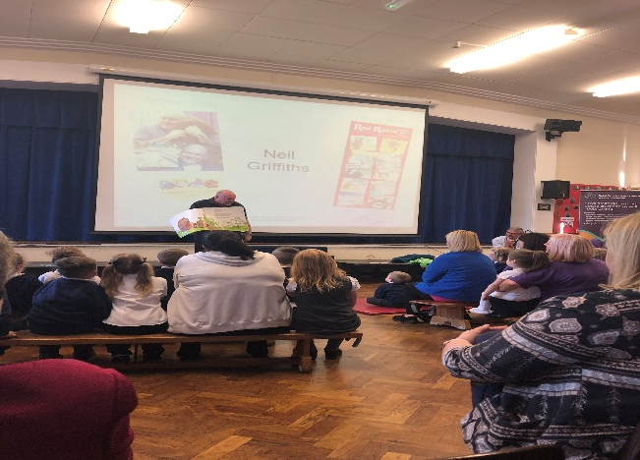
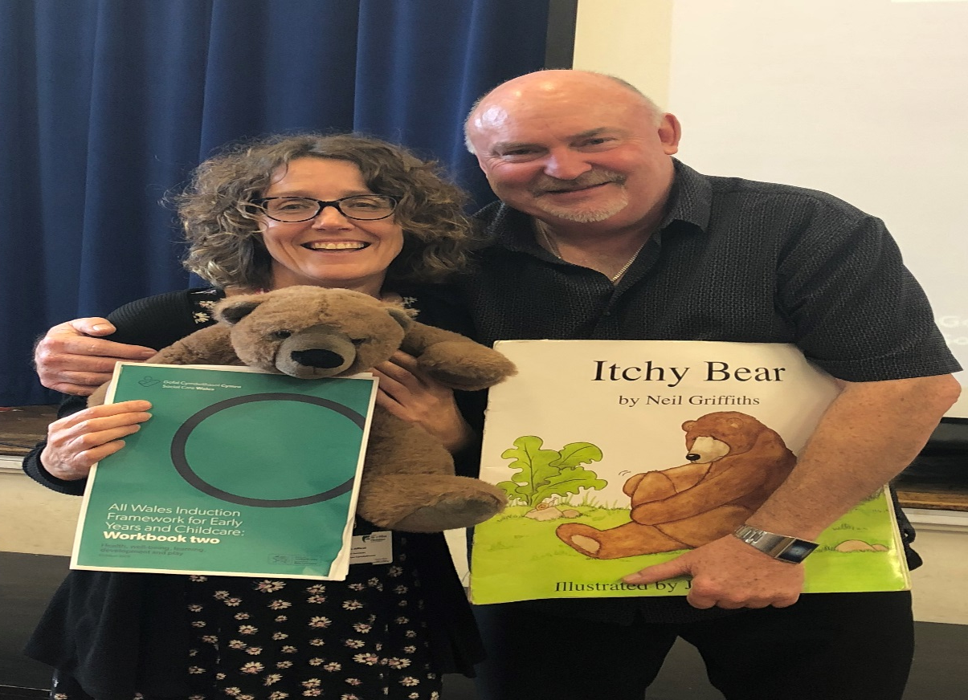
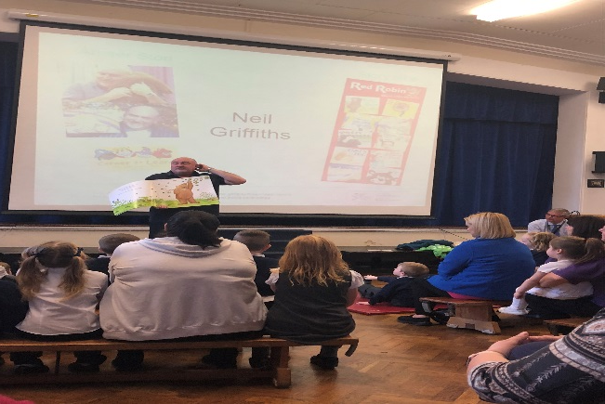
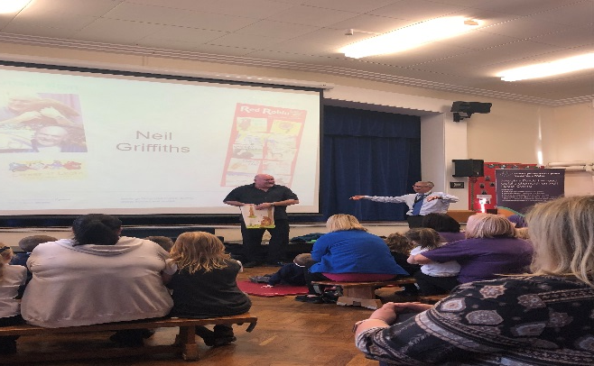
Everyone has a Story…
Building a Brighter Future’ - Key to quality provision: attachment – brain development - relationships – self-regulation – play – social skills …

