Slide 1
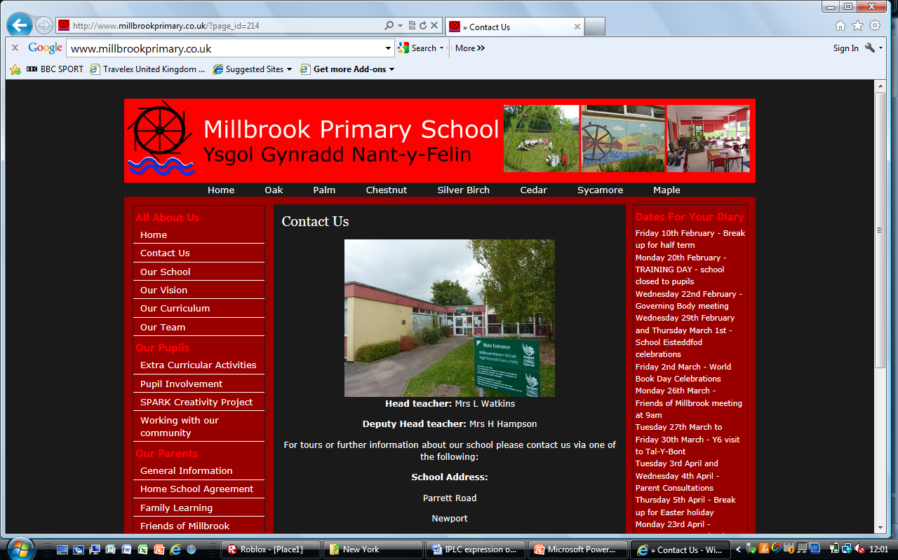



“Connecting the pieces…
…developing Newport Early Learning Community.”
Lindsey Watkins
Head teacher,
Millbrook Primary School.

Slide 2

Millbrook as a key agent of change
We have been researching approaches to improve the life chances and attainment of our children for many years. Our research has been local, national and on an international scale even visiting community school settings in the USA.
As a result of the research we have worked with Newport City Council and other key partners to develop a multi-agency approach. We have helped to pilot Children First – a place-based approach based a theory of change.
It takes a whole village
to raise a child…

Slide 3
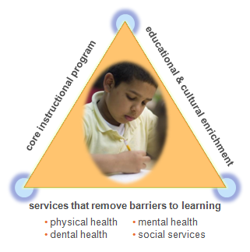
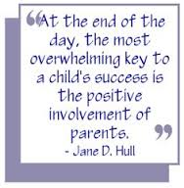
Our Philosophy…
Happy children learn
To support the child effectively we must support the family
To support the family effectively, we must support and embrace the community
On site multi-agency support for families and the community supports us in this vision.
This is most effective when we engage with children & their families from a very early age.
Child
Family
Community
By nurturing families and the community in this way we give our pupils the very best chance to achieve. This enables us to bridge the poverty gap.

Slide 4
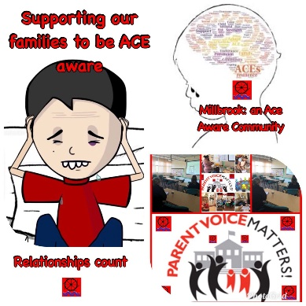
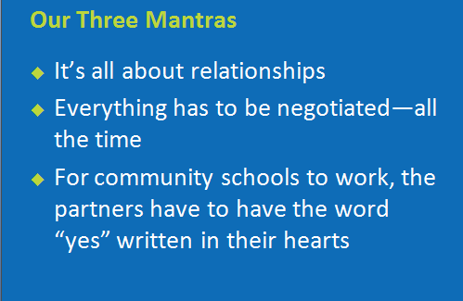
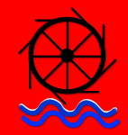
Being
ACE
Aware
It’s all about relationships!
Millbrook Primary has developed good working relationships with all of its key partners.
Millbrook Primary continuously works at it relationships with each of its key partners through regular meetings – this is now being structured and developed further by Newport ELC. Just like a family – there can be differences of opinion.
Yes!
Our Newport ELC shares the same vision and goal – we all have yes written in our hearts.
“Learning about caring;
caring about learning.”

Slide 5

Partnership Power
A structure of multi-agency work has been set up and established across Newport over the last few years. Known locally as Team Around the Cluster, a variety of agencies are located within each cluster at a school or similar setting. Agencies include: Families First, Flying Start, Social Services & Education Welfare.
Millbrook Primary is one of the host sites for Team Around the Cluster. Since this has been established, Millbrook Primary has seen a significant reduction in the number of Children on the Child Protection Register. The most influential factor for this, is the way in which the agencies work together.
Each agency is a key piece of our Early Learning Community jigsaw. We need to connect them together to make the work have most impact.

Slide 6
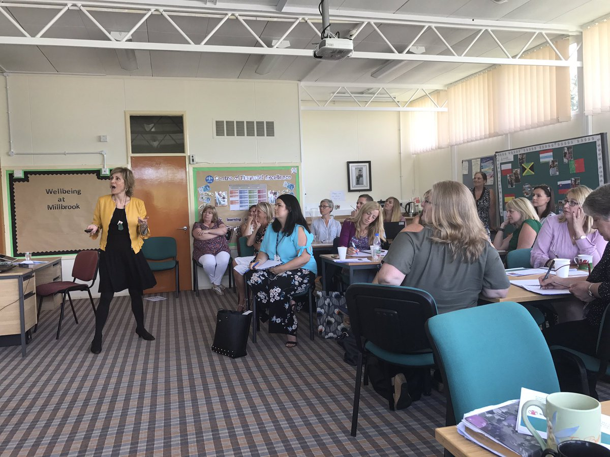
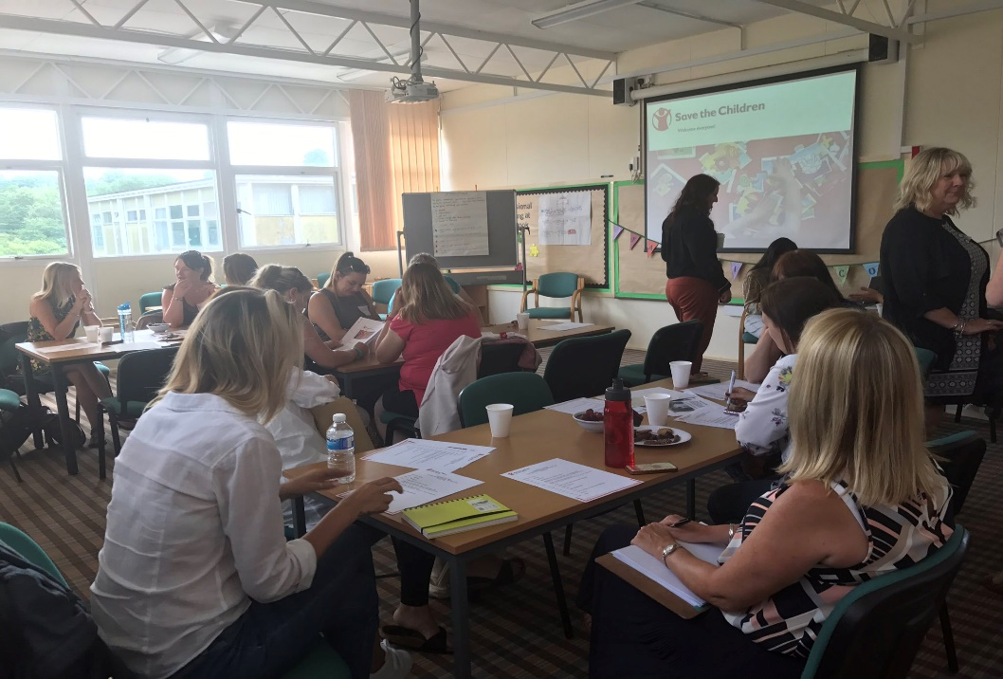
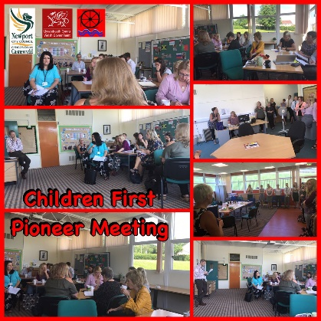

Multi-agency
Training
We have had a firm focus on ensuring consistency amongst the way that we work across clusters. This has led to:
multi-agency training
Shared practice
Site visits to other settings and to Children’s Centres across the UK
Research and review facilitated by Welsh Government and Save the Children.

Slide 7


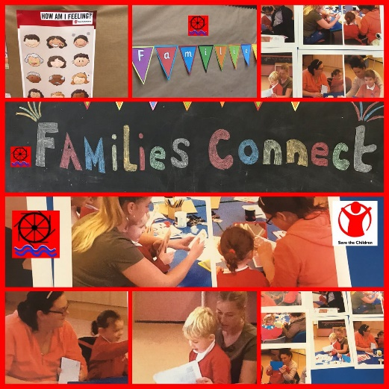
Making a difference through
Multi-agency collaboration
Collaboration across agencies has strengthened the provision that we offer to our families and our communities. This includes:
Collaboration with Gwent Police to train staff across Newport and establish Operation Encompass. This allows the early exchange of information between education and police when domestic violence has occurred.
Collaboration with Gwent Police to pilot and establish the Heddlu Bach/Mini Police initiative
Collaboration with The Ace Hub Wales and The Education Achievement Service. All schools across Newport have had ACE training for professionals. Through the pilot we have provided multi-agency training. As a result, we have developed training for families at Millbrook.
Collaboration with Save the Children Wales has enabled us to research and pilot Families Connect for 3 year olds as a new early intervention programme.
Collaboration with Barnardos Cymru to pilot a child-centred approach.

Slide 8
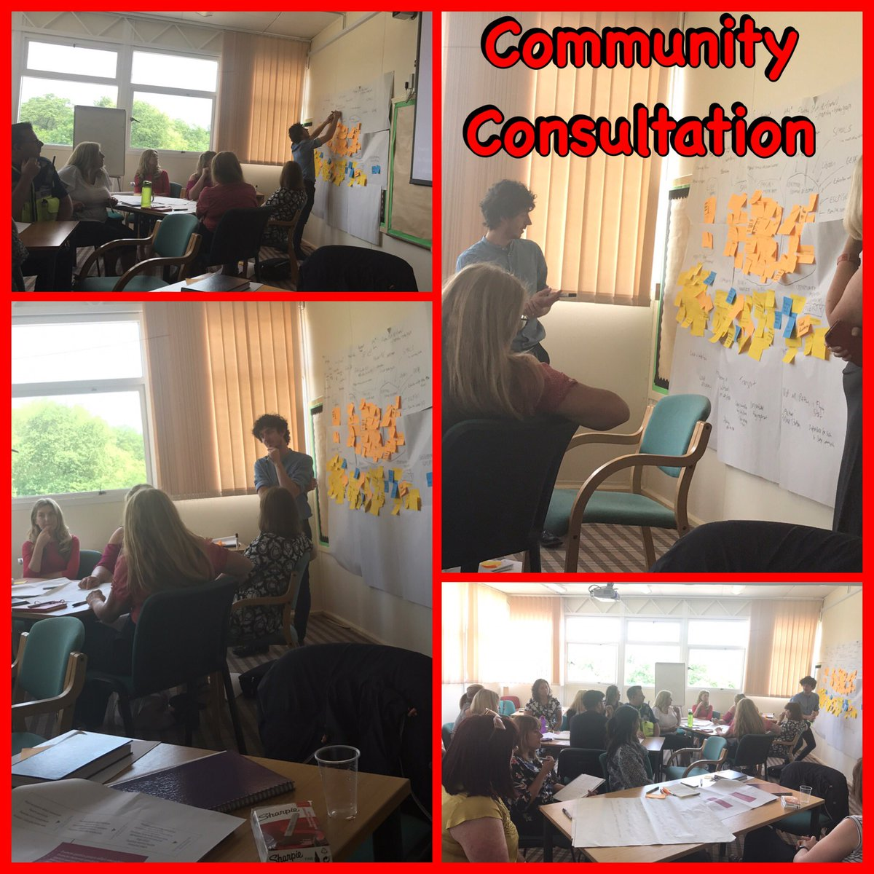
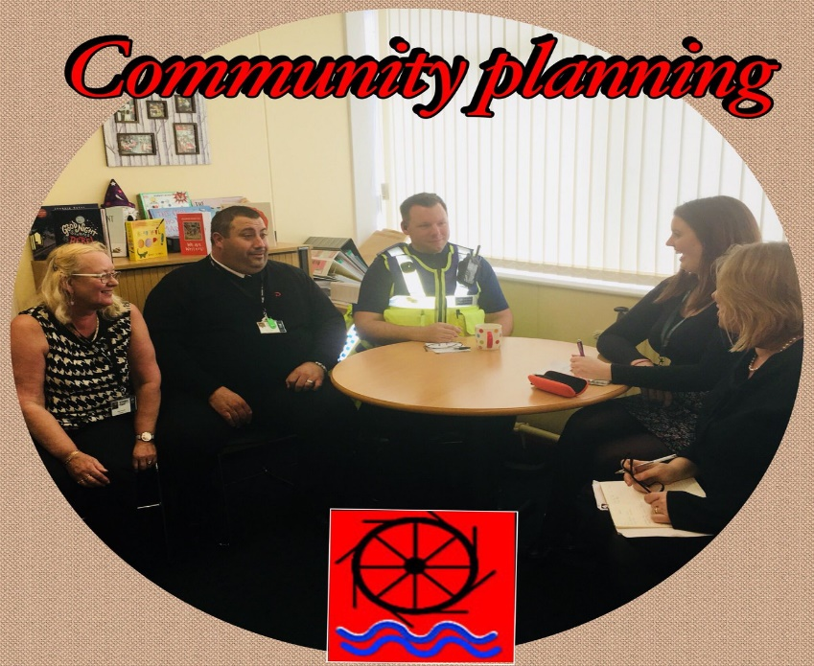
Making a difference through
Community collaboration
Following training, we have adopted a Theory of Change model and have striven to collaborate with our community directly.
This has led to the development of a variety of community initiatives aimed at tackling local issues. For example:
Community safety – the mini police have collaborated to promote a safer parking campaign
A more resilient community – a Pride in Bettws group has been set up and the school and residents have taken part in a number of litter picks
An Ace aware community – a group of parents have presented at a conference to raise awareness of ACEs.

Slide 9
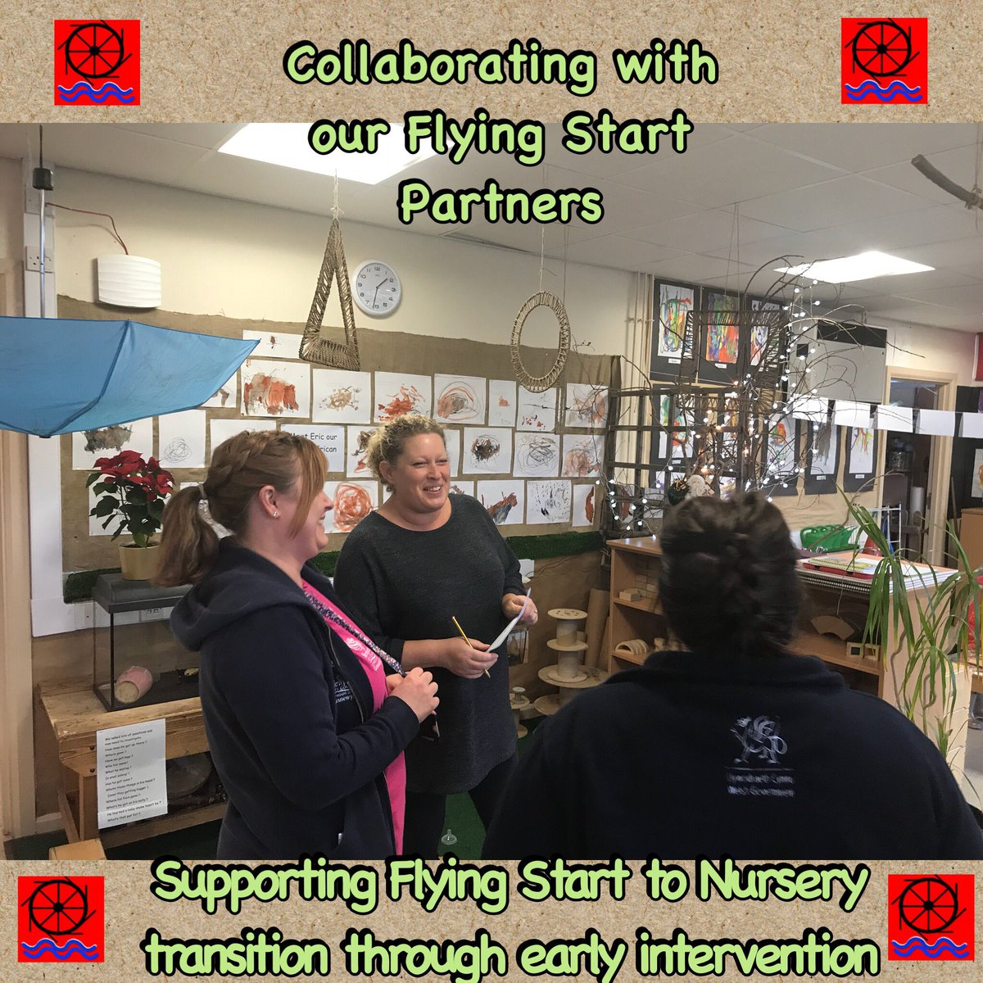



Early Collaboration
Staff from both settings work closely together as one team to:
share ideas and professional learning on early years pedagogy- this has helped to develop a consistent approach
Provide children and families with enhanced learning opportunities eg use of the onsite forest school environment
To share learning experiences to support transition eg visits to both settings by both children and families
To exchange information ensuring that we both provide the best possible support

Slide 10
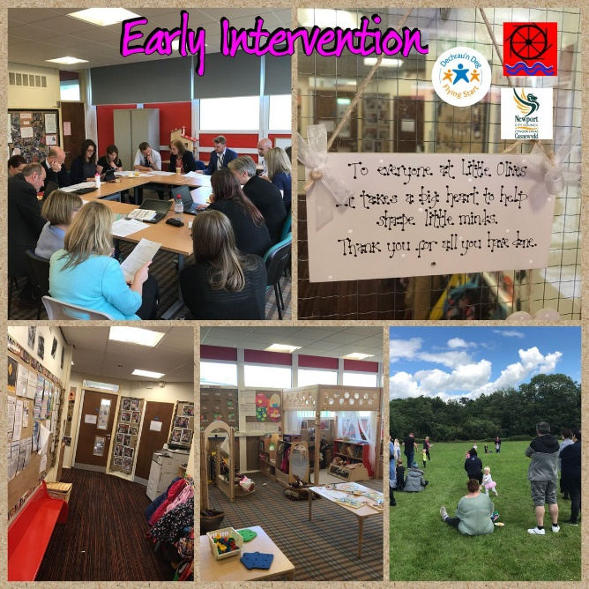
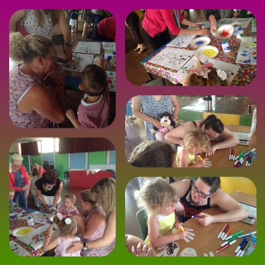
Early Intervention
Multi-agency panel meetings help to ensure that our onsite Family First provision is appropriately allocated. These allocate provision for families across our cluster and beyond.
Family learning opportunities begin in Flying Start and are continued in Millbrook Little Acorns Nursery.
Relationships are built and developed with families from an early stage.
This is continued throughout a child’s time in nursery and then into reception and beyond.
We conduct home visits for all nursery children to further build relationships and find out what further support may be needed by the child and the family.

Slide 11
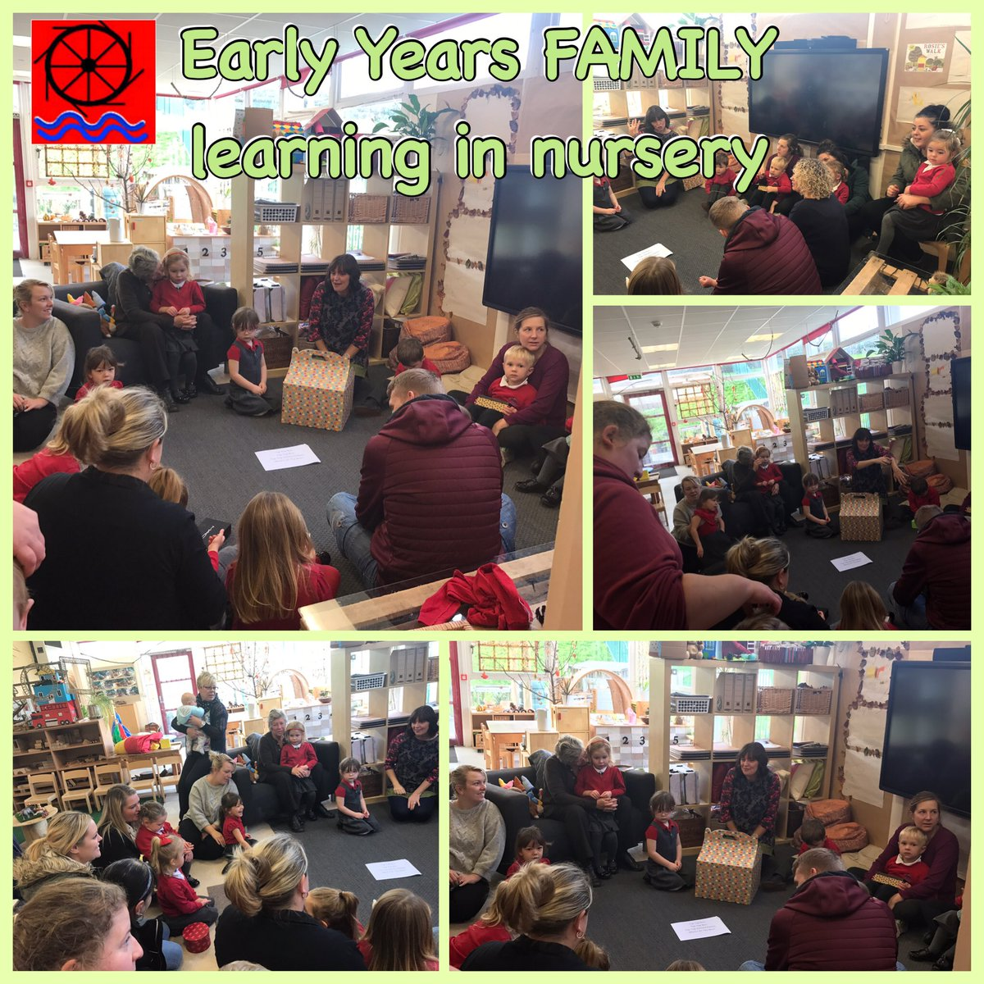
Early Intervention: family learning
Parents & family members have regular opportunities to join us in Flying Start, nursery and throughout the school. This has helped to further forge bonds between families and their children as well as strengthening the positive relationship between home and school.
Parents are our most important partners.

Slide 12
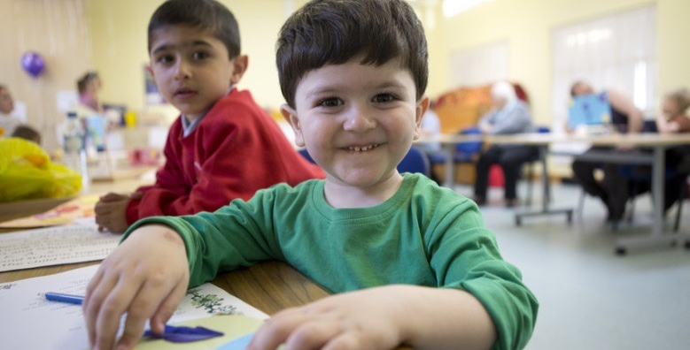
Systems Change
DEVELOPING NEWPORT EARLY LEARNING COMMUNITY
We are taking a systems
change approach
This means working in partnership to improve children’s life chances by addressing how people work together across a community, and what is going on under the surface.
We are digging deeper to further improve our partnership working by creating Newport Early Learning Community. Save the Children Wales are supporting us in this goal. Our goal is to make the pieces of our jigsaw fit even better……

Slide 13
Overview of the Early Learning Communities project
Save the Children UK seeks to improve early learning outcomes for children growing up in poverty.
The Early Learning Communities project aims to:
What? Improve early learning outcomes
Who? For children growing up in poverty
How? Through the cumulative effects of strategic/systemic and programmatic activities in each area.
We are testing this approach by partnering with organisations with the same ambition in four Communities across the UK.

Slide 14
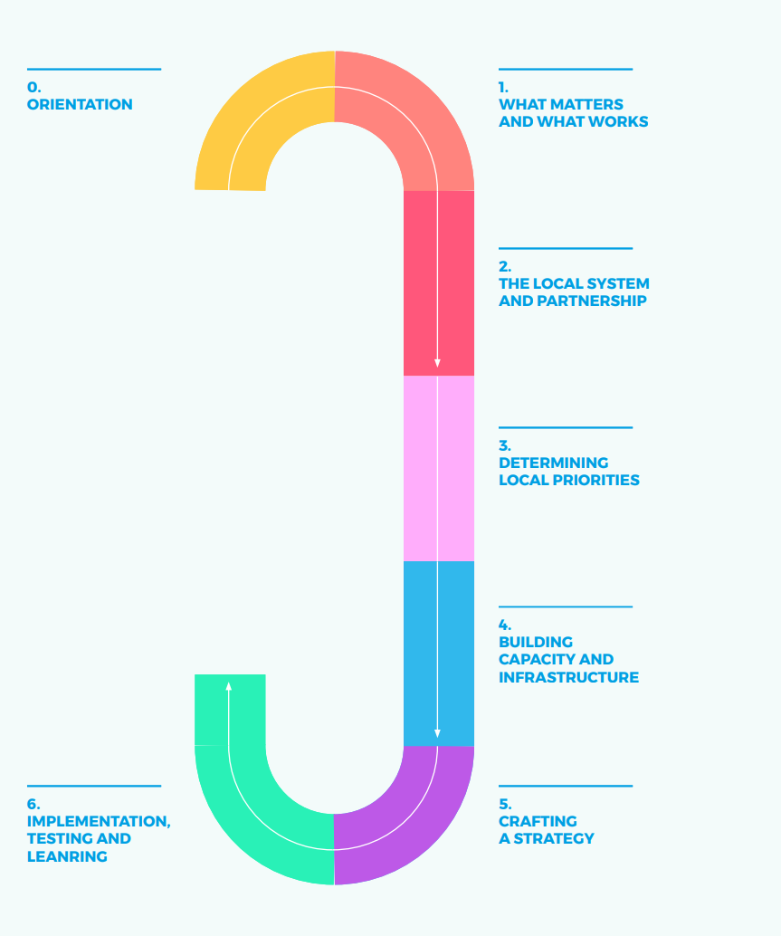
The Newport Early Learning
Community Toolkit
Save the Children have developed a toolkit for Newport Early Learning Community based on research and evidence. The toolkit:
Draws together conversations across all Early Learning communities
Gives a process for developing an Early Learning Startegy for our local area
Provides a template for our local strategy
Provides a tool for engaging with the evidence on improving early learning outcomes
Provides resources and expertise
Enables us to continuously reflect, test and learn

Slide 15

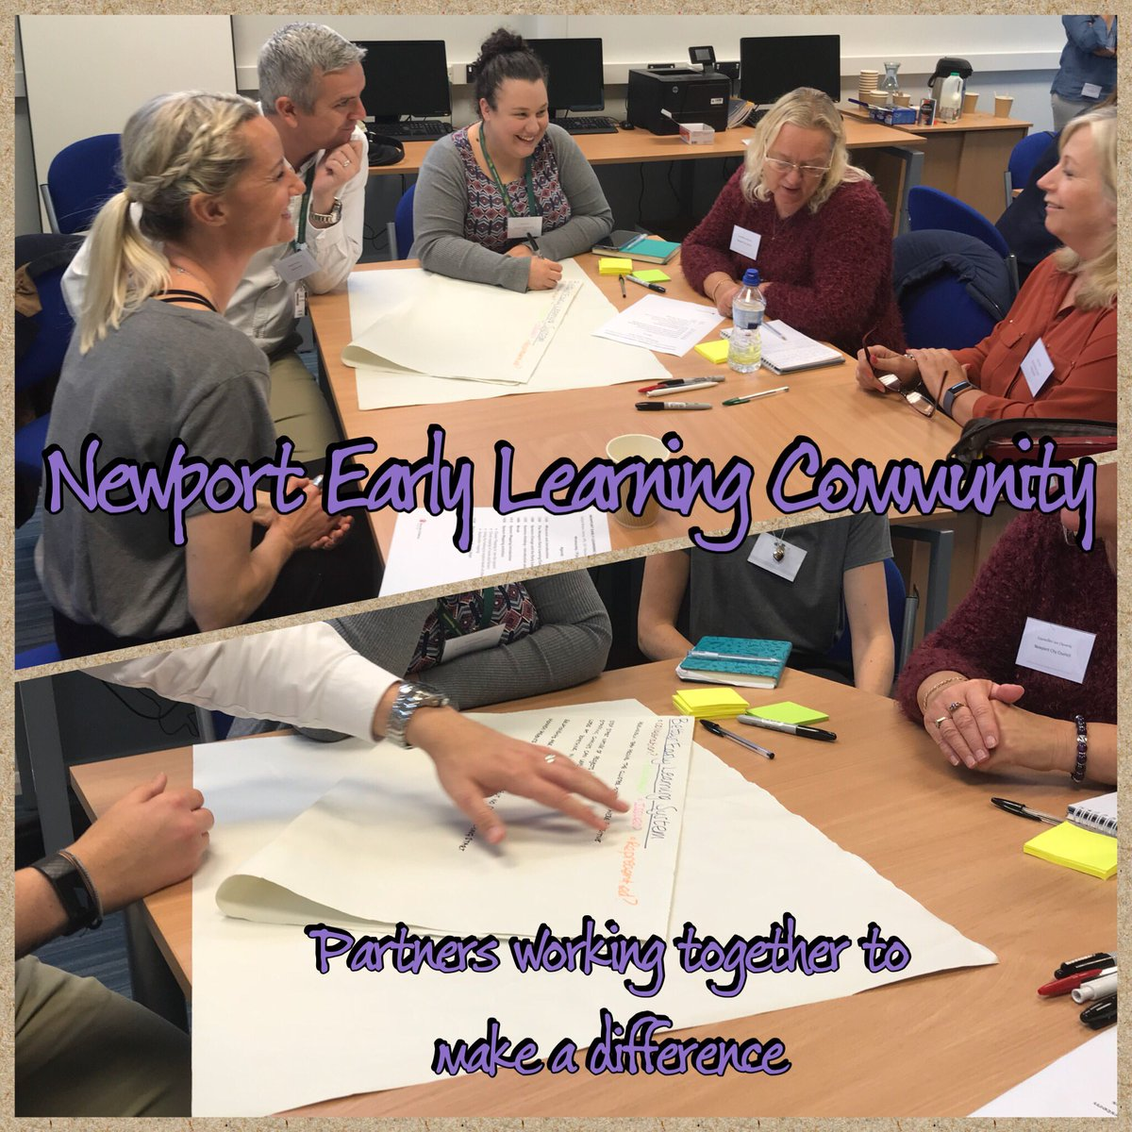
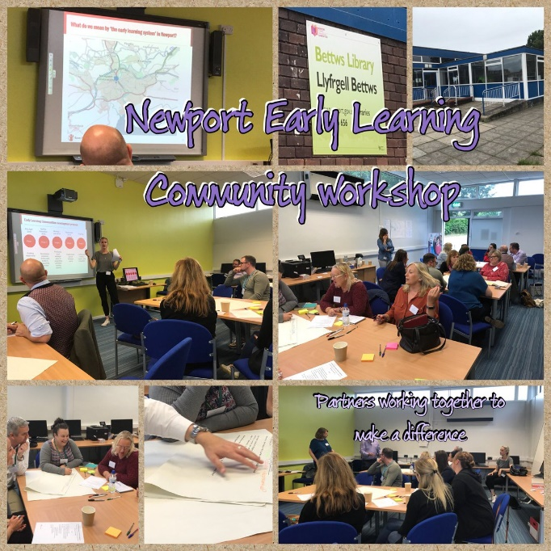
Partners working together to bring
about systems change
We have already begun this work in Bettws. Partners have come together to discuss provision and think of smarter ways of working.

Slide 16
Together we can connect the pieces of the Jigsaw
and make a difference

