Slide 1

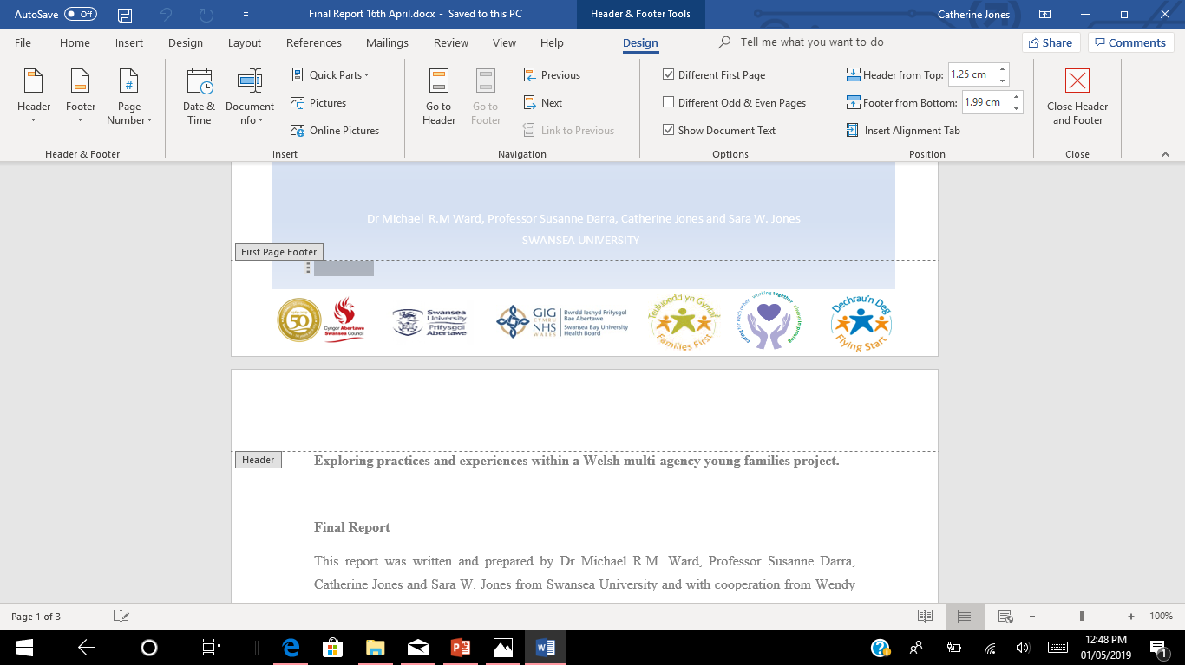
Sally Roberts, Miranda Griffiths and Sam Jenkins
Supporting Pregnant Teenagers with Complex Social Factors
Exploring practices and experiences within the
JIG-SO multiagency young families project
Study funded by the Wales School for Social Care Research

Slide 2


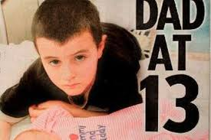
What is JIG-SO?
A multi-agency, multi-professional project, delivered by health and the local authority.
A dedicated team of co-located Midwives, Family Facilitators, Nursery Nurses, Early Language Development Workers and Managers.
Work across Swansea local authority.
Work with young parents aged 18 and under, and families under 25 with additional complex social needs.
Worked with over 600 families

Slide 3
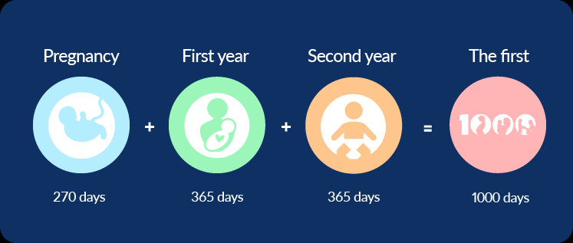

The aim of the
JIG-SO service
The Jig-so Project focuses on the first 1000 days of a child’s life and aims to provide services from conception up to a child’s second or third birthday to fill any gaps in provision with Statutory services during the antenatal and postnatal period.
Offer group and one-to-one services.
Notes:
Parenting groups and relationships groups
GroBrain, antenatal programme

Slide 4

What makes the service different?
Early intervention and prevention
92% of our referrals come from generic midwifery services.
Antenatal service is a universal service
Pregnancy and the post natal period are “key times” for early intervention
It is when expectant parents are “at their most motivated to learn”, and want to do the best for their child.
Well-being of Future Generations (Wales) Act 2015
Marmot
Building Brighter Futures
First 1000 Days Graham Allen
ACEs
Notes:
Interventions by the JIG-SO multiagency team meet the
requirements of the Act:
Work together better
Involve people reflecting the diversity of our communities
Look to the long term as well as focusing on now
Take action to try and stop problems getting worse - or even stop them happening in the first place.

Slide 5



The Jig-so Journey
Referral in by maternity services after booking at 14/40 by core maternity services.
Jig-so Midwifery initial assessment of need to establish what part of the service is required.
Jig-so Midwifery /Nursery nurse core program 14 extra visits. – Antenatal nurturing
Referral to Parenting worker Advocacy, relationship tenancy, financial issues
Invite to groups:- Antenatal, Aquanatal yoga Postnatal , Parents as partners relationship , Parenting
Ongoing one to one support from family facilitators for up to three years dependent on need.

Slide 6

Why is JIG-SO needed?
“The moment a child is born the parents are also born”
Having additional social complex needs can make this even harder.
Young parents
Parents with mental health issues
Substance misuse
Learning difficulties
Makes the parenting journey far more challenging and makes these families more likely to experience adverse outcomes

Slide 7
ADVERSE CHILDHOOD EXPERIENCES.
The evidence is very clear those who experience poor quality and stressful childhoods are more likely to have poor life outcomes and the more ACES encountered the greater the risk posed.
Evidence shows that children who are exposed to 4 or more ACES makes you more likely to develop health harming and antisocial behaviours, perform poorly at school, be involved with crime and be less likely to be a productive member of society. They are more likely to develop heart disease , frequently visit the GP, develop type 2 diabetes, experience significant mental health problems.
Providing a safe and nurturing environment is the best way to ensure a child will become a healthier and happier adult and one who will go on to achieve their full potential.

Slide 8

Adverse Childhood Experiences (ACEs): study in JIG-SO
Number of ACE’s | JIG-SO % | WALES AVERAGE %
0 | 5% | 53%
1 | 11% | 20%
2-3 | 22% | 13%
4+ | 62% | 14%
ACEs should not been seen as someone’s destiny. There is much that can be done to offer hope and build resilience

Slide 9


What makes a difference to our Jig-so families
Bringing the 2 teams together means we can use the links our midwives have in health and the links our parenting workers have in all the other services means we can support all the of families needs.
The support is tailored to each families individual needs.

Slide 10
Services who we work with to provide support to young families
Midwifery services
Health Visitors
Integrated sexual health
Perinatal Mental Health Services
Social Services
Action for Children (SAIL Project)
Housing Department
Tenancy Support
Bays Project
Info Nation
Welfare Rights
Pace project
Domestic Abuse Services
South Wales Police
Barod
Communities for Work
Family Wellbeing Team
Family Partnership Team
Family Intervention Team
Foodbanks
List not exhaustive

Slide 11
Outcomes in JIG-SO
Collaborative working with social services resulted in:
151 of the families were open to Social Services (2017/18)
Families engaged 132
of that 132 – 15 were removed = 11%
Families not engaging 19
of that 19 – 15 were removed = 79%
64 children coming off the child protection register
85 closed to social services.
Notes:
Talk about how you work with social services and how it helps

Slide 12



Cost avoidance
8 randomly selected cases: using the Wavehill cost avoidance tool made for Families First funded projects in Wales.
£8,783 – potential net cost avoided per case, per annum
This equates to an average of:
Gross Potential Cost Avoided - £81,412
Approximate Intervention Cost - £11,152
Net Potential Cost Avoided - £70,260
Potential net costs avoided per annum - £1,543,140

Slide 13
 |  | Health |  | Mental Health |  | Employment | Housing |  | Social Services
Extent of Outcome | Ensuring a child is ready to enter reception at school | Addressed an alcohol misuse issue | Addressed a Addressed a drugs misuse issue issue | Addressed an adult's mental health issue relating to depression or anxiety | Addressed a child / young person's mental health issue | Supported an individual to gain employment | Prevention of a complex eviction | Prevention of a simple repossession | Prevention of a child taken into care | Prevention of a children taken into foster care | Prevention of a child taken into Residential care | Average cost of child protection core assessment (overall) | Children in Need - average total cost of case management processes annually (standard cost) | Common Assessment Framework/Proportionate Assessment: cost per assessment (overall mean cost)
Outcome achieved |  |  |  |  |  |  |  |  |  |  |  |  |  | 1
Progressing towards achieving outcome with support | 1 |  |  | 1
Referred to support service by Families First/TAF
Total count of all cases: | 0.66 | 0 | 0 | 0.66 | 0 | 0 | 0 | 0 | 0 | 0 | 0 | 0 | 0 | 1
To enter your cases in the database on the Enter Information Tab please copy the cells below In the Enter Information Tab right click in Column C on a new row Click Paste Special -> Paste Values Only Once you have entered your information please delete any information you have added in cells B3 to U6
COPY THIS LINE OF DATA INTO THE 'ENTER INFORMATION' WORKSHEET | 0.66 | 0 | 0 | 0.66 | 0 | 0 | 0 | 0 | 0 | 0 | 0 | 0 | 0 | 1

Slide 14

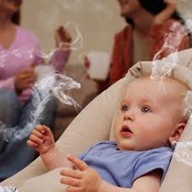

Welsh Government Key Performance Indicators for Maternity Services
Smoking: 2017 /2018
JIG-SO services
52.6% of young women smoked in early pregnancy
Of these, 25.5% stopped smoking during pregnancy
ABMU Health Board
17.86% of women smoked in early pregnancy
Of these, 6% stopped.

Slide 15

Welsh Government Key Performance Indicators for
Maternity Services
Breastfeeding | JIG-SO | ABMU | WALES
 |  | 2017
At Birth | 69.3% | 64.6% | 56.7%
At 10 days | 48.5% | 28.9% | 42.6%
At discharge from JIGSO (around 28 days) or at 6 weeks (ABMU/Wales) | 39.6% | 33.0% | 34.2%
 |  | 2018
At Birth | 58.2% | 54.2% (Jan-Sept) | 57.8% (Jan-Sept)
At 10 days | 26.4% | 34.1% (Jan-Sept) | 44.5% (Jan-Sept)
At discharge from JIGSO (around 28 days) or at 6 weeks (ABMU/Wales) | 22.0% | 33.0% (Jan-Sept) | 34.16% (Jan-Sept)

Slide 16


The JIG-SO Research
Notes:
Based in the College of Human and Health Sciences at Swansea University.
With cooperation from Wendy Sunderland-Evans, Mike Davis and Anna-Marie Sales from Abertawe Bro-Morgannwg University Health Board/Swansea Council, JIG-SO.
Funded by Wales School for Social Care Research, through their Social Care Research Capacity Building Grant.
Ran from April 2018-April 2019.

Slide 17

The Research Team
Catherine Jones – Researcher [focus groups/observations young people]
Professor Susanne Darra - Principal investigator [Observations and Focus Groups with staff]
Dr Michael R.M. Ward - Co-Investigator [Observations of Relationships Programme]
Sara W. Jones - Researcher [Data analysis of JIG-SO data]
For any further information please contact m.r.m.ward@swansea.ac.uk or s.darra@swansea.ac.uk

Slide 18
Exploring practices and experiences within a Welsh multi-agency young families project.
Research Aim and Questions
To explore in what ways the jig-so project is ‘working’, from the perspectives of service users and service providers.
To discover how the project might be improved.
To consider how the project might be replicated in other areas of wales (and the UK more broadly).
Notes:
The study sought to address the following research objectives:

Slide 19

Background to the Study
It is well recognised that families, especially young families, need a wide range of support in order to tackle and reduce health and social inequalities.
This support must start before birth and be followed throughout the early life of a child.
Teenage pregnancy is strongly related to social and health inequalities and supporting young parents is key to a babies future life chances.
One key factor which has been identified in reducing health and social inequalities are prudent healthcare strategies which suggest that through coproduction and collaboration public and professionals can be equal partners.
The Well-being of Future Generations (Wales) Act 2015 (Welsh Government, 2015) argues that this is key to improving the social, economic, environmental and cultural well-being of Wales.
JIG-SO an example of this collaborative working.
Notes:
Sally and Julie have both touched upon why it is important to support young families, so I won’t go into too much detail.

Slide 20

Phase One:
Improvements in measurable outcomes. (high levels of smoking cessation, alcohol abstention, longer breastfeeding duration and diet).
Young parents reported feeling more confident as a parent. Rated themselves higher in self-assessed scores than before their engagement with the service.
Led to better outcomes for the young parents.
High proportion of cases were closed to social services or removed from the ‘at risk’ register.
Engaging with JIG-SO resulted in more children remaining with their parents.
Notes:
1. Our research found that a close, collaborative working relationships and joined-up practice between the multi-agency partners, enabled a high level of communication to meet service users’ often complex needs. these joined-up working practices within jig-so, or what we term the JIG-SO model created a team or 'family' unit around a young parent. (linking in with the Welsh Govt’s sustainable development principle).
2. On child-care activities and parent-child relationship building behaviours

Slide 21

Phase Two
Positive relationships formed with staff was due to their personal attributes (non-judgemental, supportive, friendly, reliable, empathetic)
Variety of different support available, pre and post birth.
Provided invaluable level of health information.
Support was one-to-one, group sessions or peer support groups.
Benefited from additional hours.
Staff also went above and beyond, help with food banks, housing, employment, financial worries and education.
Notes:
1. Took the time to explain procedures relating to labour, birth and parenthood.

Slide 22

They also get down to a person level with you, they can relate and just talk to you like you’re human
[Alison, Young Parent, Focus Group [FG] 2]
She’ll be brought up differently to how she would have been brought up if I didn’t have JIG-SO because the things they’ve taught me [Hannah, FG 4]
I didn’t think I’d be here with my two kids, but they made me know where I stand, they made me know what was coming next, I knew what was going to happen. [Molly, FG 4]
Just to widen our knowledge about the way in which the baby develops, things that we can do to keep the baby healthy whilst I was carrying him. [Anabelle, Young Parent, FG 2]

Slide 23
Phase two cont.
Engaging young fathers
Two mains themes identified – creation of a safe space to discuss issues and challenging gender norms and promoting caring masculinities amongst the fathers
Through exercises which challenged gender stereotypes and discussions around what traditional masculine practices looked like, young men were able to questions the consequences of destructive or negative behaviours on themselves, their partners and children.
It was here that 'caring masculinities' were fostered.
Workers adopted a non-judgemental, open attitude to the young parents and never telling them what to do but getting them to question themselves.
Provided advice on what a healthy relationship between parents might look like.

Slide 24

Phase three
The mode of collaborative working at JIG-SO is innovative and throughout Wales (and the UK) it is unusual to have midwives and local government-employed workers co-located in this manner.
The staff members showed a huge level of commitments and flexibility in their roles.
The team operated in a non-judgemental, responsive and very open way, with members of staff listening to each other’s suggestions in order to plan interventions and tailored packages of support.

Slide 25

Implications
At a time when funding and the futures of support services are under threat, our study demonstrates the vital role that agencies such as JIG-SO play in supporting young families to live healthier lives, both physically and socially.
By learning from this example of good practice, and drawing on the expertise from this collaborative approach, other local authorities could greatly benefit from what we term the ‘JIG-SO model’.
Jig-so does not have any magic parenting material the magic formula is the early referrals from Midwifery that allow very early intervention before the baby is born.

Slide 26
Implications cont.
Additionally, this research also adds to a small body of knowledge which explores how the inclusion of fathers can benefit the whole family and help prepare them for the journey ahead.
There was an awareness within the JIG-SO team of how traditional expectations of masculinity impacts on young men and their behaviours as young fathers and partners. This is another example of good practice and integral to the ‘jig-so model’ that other local authorities could benefit from.
This study highlights how JIG-SO operates within a troubling policy backdrop which includes The 1001 Critical Days Strategy and Adverse Childhood Experiences [ACEs] agenda. We argue that these are individualized solutions that often ignore poverty and inequality and are only part of what is needed to combat the disadvantaged socio-economic circumstances which shape many young parents’ lives.

Slide 27
Conclusion
Jig-so was set up to fill the gaps in the statutory services, often families only involvement with professionals in the first 1000 days will be with health services.
Having midwives in a multi-disciplinary team allows ‘very early’ intervention
Jig-so midwives have a focus on social issues as well as health.
We sometimes have 6 months to work with a family before the baby is born.
Co-locating allows high levels of communication.

Slide 28
Conclusion
Most of the staff were already in Families First funded posts they were moved into Jig-so from other projects.
This multi-agency early intervention approach is in line with recommendations from
The Marmot report
Building a Brighter Future
First 1000 days
Building Great Britons
ACE’s agenda
Midwifery Services
They all state that multi-disciplinary support from multi-agency teams are better at supporting the complex needs of families, this model is a way of taking this work forward.

Slide 29
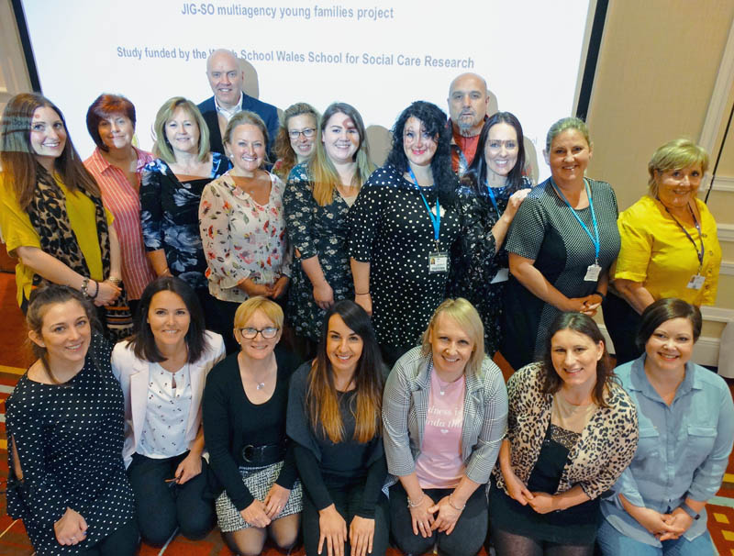

Slide 30

Thank you, any questions?
For any further information please contact:
Mike.davies5@Swansea.gov.uk
Wendy.sunderland-evans@wales.nhs.uk

