Slide 1







Early Years Vulnerability Profiling
(Preconception – Pregnancy – Birth - 0-7 years)
Julie Evans
Senior Midwife – RN, RM, BSc, MSc (Cwm Taf Morgannwg University Health Board)
Early Years Vulnerability Profiling Development Officer – (Rhondda, Cynon, Taf, CBC)

Slide 2
AIM
To realise the Cwm Taf Public Service Board agreement (July 2018) to develop an Early Years Vulnerability Profiling Model 0-7 years (Preconception, Pregnancy, Birth and Early Years) that identifies the level of need amongst individuals, families, communities alongside the investigation and removal of potential barriers to sharing information.
The Early Years Vulnerability Profiling Model will be piloted in Rhondda Cynon Taf County Borough Council boundaries, as an alternative to geographically based eligibility criteria for Flying Start services, which will support the creation of an enhanced needs based targeting methodology.

Slide 3

Research Proposal
To investigate the benefit and women/family/public acceptability of sharing data to identify pregnant women, children and young families who are vulnerable to poor outcomes with a view to improving targeted preventions through early identification and intervention measures to improve outcomes.

Slide 4
Primary Milestones
1. Recruitment of an Early Years Vulnerability Profiling Officer
2. Establish a steering group to support the Early Years Vulnerability Profiling Officer and oversee the project
3. Development of an agreed list of data sets from across all partner organisations
4. Development of an Evidence Map - Vulnerability factors and interventions in the Early Years
5. Development of an Information Sharing Protocol with partner organisations
6. Draft Vulnerability Profiling model developed and piloted in RCT
7. Pilot information reviewed, model amended as required and present to Public Service Board / Strategic Planning Board / Welsh Government
8. Plan for implementation of Early Years Vulnerability Profiling model across Rhondda Cynon Taf / Merthyr Tydfil / Bridgend
9. Dissemination/publication of learning from the Project

Slide 5

Progress to Date

Slide 6

1.Recruitment of an Early Years Vulnerability Profiling Officer
Appointed March 2019 for 1 year
Background:
Senior Midwife Cwm Taf Morgannwg University Health Board
Safeguarding
Vulnerable Women: Mental Health, Domestic Abuse, Substance Misuse
Public Health
Maternity Information Technology System
Benefits of having established relationships across the health board and RCT, Merthyr Tydfil CBC

Slide 7

2. Establish a steering group to support the Early Years Vulnerability Profiling Officer and oversee the project
Multi-agency steering group established May 2019:
Terms of reference
Action Plan
Bi-monthly meetings
1st Task & Finish meeting – Technology
2nd Task & Finish meeting – Vulnerability factors/characteristics

Slide 8
4. Development of an Evidence Map - Vulnerability factors and interventions in the Early Years
Evidence mapping exercise conducted on potential risk and vulnerability factors which can adversely affect the health of a child in the First 1000 days/early years including at pre-conception, during pregnancy, birth to 2 years and 3-7 years of age.
Scopes evidence base of potential/good practice interventions to prevent and address these risk factors and their return on investment where possible.
Identifies current potential sources of data for collection for each risk factor and potential outcome measures.
Adverse Childhood Experiences

Slide 9
4. Development of an Evidence Map - Vulnerability factors and interventions in the Early Years
Good evidence to demonstrate how better outcomes for parents and babies start long before birth hence the importance of providing preconceptual care . Women who are healthier at conception have a better chance of becoming pregnant, having a safer and healthier pregnancy and giving birth to a healthy baby.
Strong evidence to demonstrate how Pregnancy is a particularly important period during which the physical and mental well-being of the mother can have lifelong impacts on the child.
Evidence demonstrates that children’s chances in life are strongly influenced by their experience during the early years. Physical, social, emotional and cognitive development in the early years not only impacts on health outcomes throughout the life course, but also on other domains such as educational attainment, employment or income (Marmot et al., 2010).
Evidence demonstrates that risk factors can continue to be present for the child after 2 years of age (Emond 2019). According to Bellis et al (2015) there is a growing body of evidence that our experiences during childhood can affect health throughout the life course.

Slide 10


3. Development of an agreed list of data sets from across all partner organisations
Educational Profiling scoped across the 3 local authorities: Rhondda Cynon Taf, Merthyr Tydfil, Bridgend.
List of potential risk factors/characteristics presented and discussed at a dedicated Multi-Agency Task & Finish Group.
Signed off by Steering group

Slide 11






Agreed Early Years Vulnerability Risk Factors/Characteristics

Slide 12
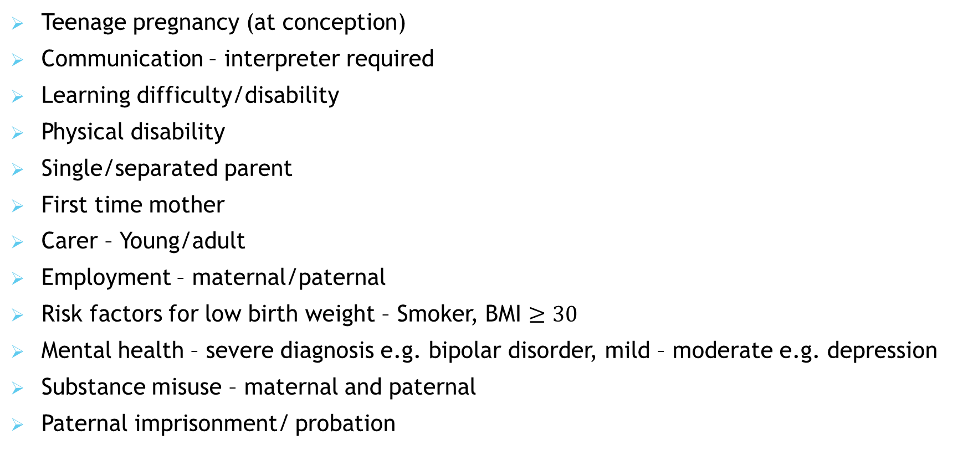
Pregnancy Vulnerability Factors
Teenage pregnancy (at conception)
Communication – interpreter required
Learning difficulty/disability
Physical disability
Single/separated parent
First time mother
Carer – Young/adult
Employment – maternal/paternal
Risk factors for low birth weight – Smoker, BMI $≥30$
Mental health – severe diagnosis e.g. bipolar disorder, mild – moderate e.g. depression
Substance misuse – maternal and paternal
Paternal imprisonment/ probation

Slide 13
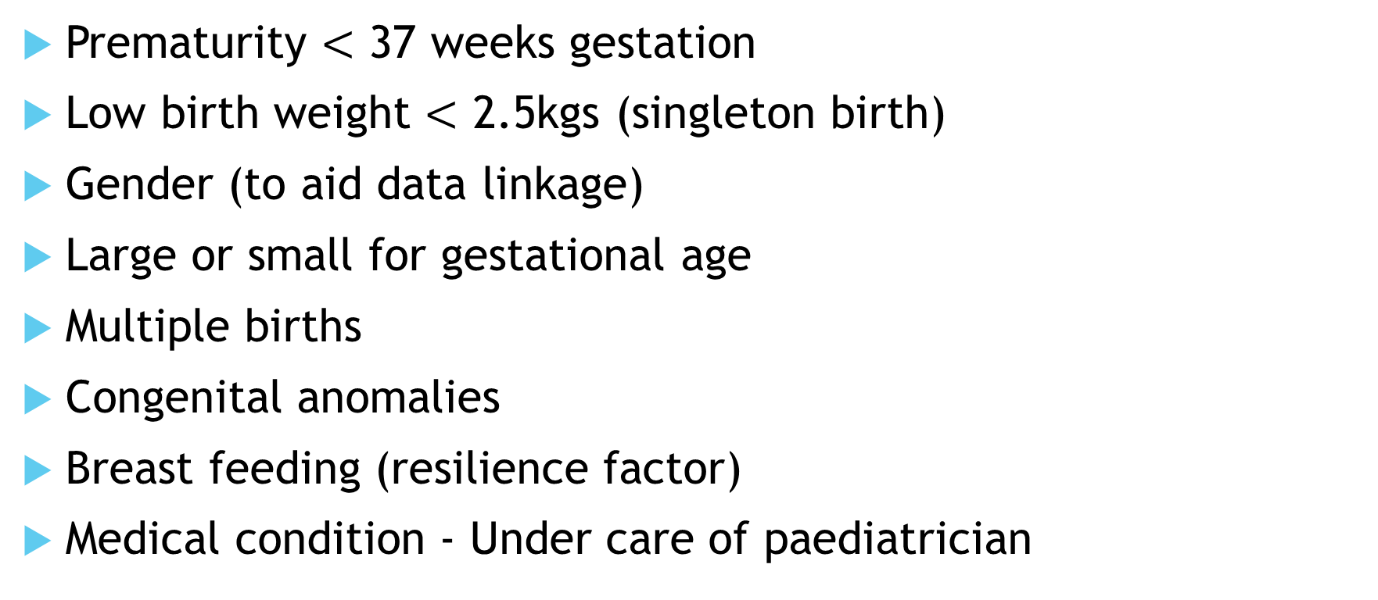
New-born/Infant Vulnerability Factors
Prematurity $<$ 37 weeks gestation
Low birth weight $<$ 2.5kgs (singleton birth)
Gender (to aid data linkage)
Large or small for gestational age
Multiple births
Congenital anomalies
Breast feeding (resilience factor)
Medical condition - Under care of paediatrician

Slide 14
Infant / Child Vulnerability Factors
Positive result - New-born “Bloodspot” Screening Wales Programme: Congenital hypothyroidism, inherited metabolic disorders, sickle cell disorders, cystic fibrosis
Hearing impairment
Speech & language
Neurodevelopment
Child weight
Dietetics
Immunisation uptake
Childhood injuries – Accident & Emergency attendance
Community Adolescent Mental Health Service (CAMHS)
Oral health – dental extractions under sedation/general anaesthetic for tooth decay

Slide 15

Safeguarding Vulnerability Factors
Maternal – was/is a child looked after
Team around the Family/Resilience Service
Child in need of care and support
Child protection
Child in foster care
Female genital mutilation
Domestic Abuse - Multi-Agency Risk Assessment Conference (MARAC)

Slide 16

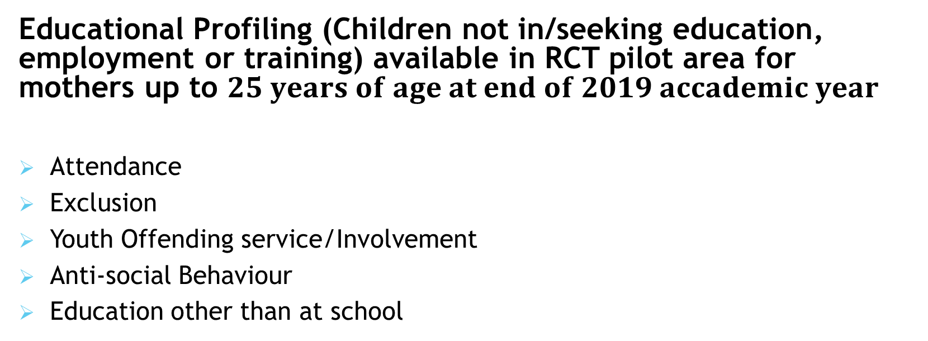
Education Vulnerability Profiling Factors
Educational Profiling (Children not in/seeking education, employment or training) available in RCT pilot area for mothers up to $25 years of age at end of 2019 accademic year$
Attendance
Exclusion
Youth Offending service/Involvement
Anti-social Behaviour
Education other than at school

Slide 17

5. Development of an Information Sharing Protocol with partner organisations
Early engagement and partnership working with Data Governance leads for key organisations to facilitate development of an Information Sharing Protocol.
Information Sharing Protocol in development

Slide 18
6. Draft Vulnerability Profiling model developed and piloted in RCT
Engagement with all key partners at local and national levels to improve communication and working relationships between key stakeholders, ensuring they are fully aware of the Early Years Vulnerability Profiling work and gain their buy in to supporting the development of the model.
Evidence mapping completed
Agency documentation mapping exercise completed
List of Early Years Vulnerability risk factors/characteristics developed
Data systems scoped and data availability, assurance and gaps identified
NHS number unique identifier (allocated at birth) to facilitate data linkage
Recommendation report to highlight additional questions/data fields to improve quality assurance and future data availability

Slide 19
Pilot
Last 4 financial years
2015/16, 2016/17, 2017/18, 2018/19
Rhondda Cynon Taf CBC births only
Includes: 13,521 live births, 2284 mothers with potential to have an educational profile
Data Analysis
Weighting of the risk factors to be completed following initial analysis
After initial individual analysis of vulnerability comparison will be made against current geographical based eligibility criteria for Flying Start services

Slide 20


Next Stages
7. Pilot information to be reviewed, model amended as required and present to Public Service Board / Strategic Planning Board / Welsh Government
8.Plan to be agreed for implementation of Early Years Vulnerability Profiling model across Rhondda Cynon Taf / Merthyr Tydfil / Bridgend
9.Dissemination/Publication of learning from the Project

Slide 21

Thank you
Any Questions?

