Slide 1
Early Years Integration Pathfinder Workshop (Swansea, 02/05/19)
An Introduction to Theory of Change & Logic Models
Launa Anderson (Head of Social Justice Research)

Slide 2
Session Purpose
Provide an introduction to these concepts, but it is not exhaustive and it is not formal training!
Build your knowledge and confidence around the use of theory of change tools.
To provide an opportunity for discussion and reflection around the programme theory / logic model components for Early Years System Transformation in your area.
Encourage you to take this thinking back to your areas and how you could apply it.
Provide a signpost to some resources you can use.
Think about what support you might need.

Slide 3
What is a theory of change?
“…a story about how the activities included in a project are going to lead to their intended outcomes – early on, and in the intermediate and the longer term.”
Jim Connell and Anne Kubisch (2002)
“A program is a theory and an evaluation is its test. In order to organize the evaluation to provide a responsible test, the evaluator needs to understand the theoretical premises on which the program is based.”
Carol Weiss (1972)

Slide 4
Theory of Change definition
A Theory of Change is essentially a comprehensive description and illustration of how and why a desired change is expected to happen in a particular context. It is focussed in particular on mapping out what has been described as the ‘missing middle’ between what a programme or change initiative does and how these lead to desired goals being achieved. It does this by identifying long-term goals and then works backwards to identify all the conditions (outcomes) that must be in place for the goals to occur.
Resource: Center for Theory of Change

Slide 5
Theory of change definitions continued…
A programme theory can be used to provide a conceptual framework for monitoring, for evaluation, or for an integrated monitoring and evaluation framework.
A programme theory can be a very useful way of bringing together existing evidence about a programme, and clarifying where there is agreement and disagreement about how the programme is understood to work, and where there are gaps in the evidence.
Source: Better Evaluation

Slide 6
Theory of change definitions continued…
A theory of change explains how interventions are understood to contribute to a chain of results that produce the intended or actual impacts.
Impacts can be positive or negative.
It can also show the other factors which contribute to producing impacts, such as context and other projects and programmes.

Slide 7
Logic Model definition
Different types of diagrams can be used to represent a theory of change.
These diagrams are often referred to as logic models, as they show the overall logic of how the intervention is understood to work.
The logic model is a graphical way of describing the theory of change not the theory of change itself.

Slide 8
Developing a Theory of Change can help to…
Reach consensus on how something is intended to work and identify areas of disagreement or uncertainty.
Communicate ideas to stakeholders about your intentions and the logic behind your approach.
Make sense of other people’s ideas and replay them in a logical way.
Make links between components of a programme/policy/initiative.
Identify alternative explanations and make sense of unintended results or counterintuitive findings.
Clarify who is responsible for what and what is actually feasible (managing expectations).
Compare the observed reality to ‘something’ and refine the theory.

Slide 9
Simple example of a theory of change logic model

Slide 10
Logic model – a worked example

Slide 11
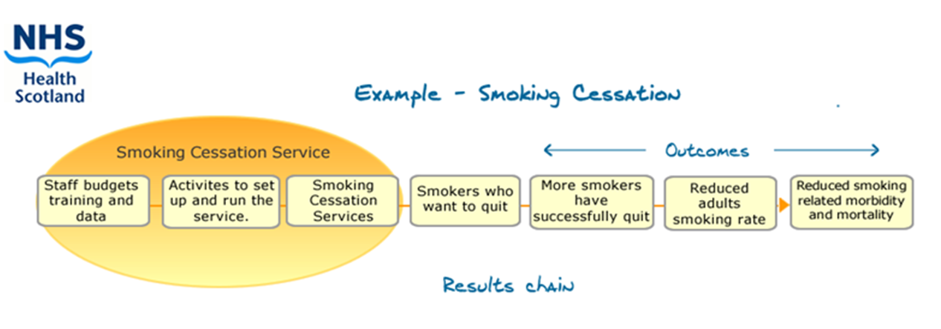
A simple example of a logic model

Slide 12
Logic models can:
be developed before a programme starts, and used for planning, to develop monitoring systems, and for evaluation and reporting
be developed during implementation and even after a programme has finished
be developed by programme staff, an external evaluator, by programme designers, or collaboratively with a community or user group
be a very useful way of bringing together existing evidence about a programme, and clarifying where there is agreement and disagreement about how the programme is understood to work, and where there are gaps in the evidence
change as we learn more and refine our theory of change. They need not be set in stone and there needn’t be a single view.

Slide 13
Logic models
Articulating mental models – talking individually or in groups with key informants (policy-makers, service deliverers and service users) about how they understand an intervention works.
Back-casting – working backwards from a desirable future, to the present in order to determine the feasibility of an idea.
Using existing evidence – using the findings from previously conducted evaluations and research, or even anecdotal/descriptive evidence.
Project/programme documents and guidance to develop the model during implementation.

Slide 14
Key components of a Logic Model
Inputs → Outputs → Outcomes
Inputs
Certain resources are needed to operate a programme.
Activities
Planned and delivered activities using these resources.
Outputs
If the activities are accomplished certain things will be delivered.
Intermediate outcomes
If you accomplish the activities to the extent you wish then recipients will benefit in a certain way.
Impacts
The achieved benefits will lead to wider societal impacts.
Assumptions
External Factors
Notes:
Inputs - What goes into the programme?
Staff
Time
Money
Equipment
Partnerships
The evidence base
Activities:
What is done and who is reached?
Activities
Services
Events
Products.
Outputs:
Direct products resulting from the programme
Number of people seen
Guidance produced
Outcomes:
The result or change that happened.
Useful to think in terms of short-, medium and long.
Useful markers of change along the way to impact
Long term outcomes are usually discussed as impact
Impacts
Long-term results.
Can often take many years to materialise
Wider societal and economic impacts

Slide 15
External Factors & Assumptions
External factors are outside the control of the programme but can influence the way in which it works. Think here of systems, culture, economic factors, demography, political backdrop.
Assumptions, implicit and explicit beliefs about the way things work. Also values and moral imperatives. Faulty assumptions can be the reason why something doesn’t work.

Slide 16
Group discussions
In your tables, consider what you think the theory of change for the Early Years System in your local area is?
Consider the logic model components as a way to articulate the theory of change.
What are the assumptions that you hold? Should these be challenged?
What practical steps would you need to take to be able to do this in your local area?
Do you think this approach would work for you?
What support do you think would be helpful?

Slide 17
Resources
The Magenta Book (HM Treasury) - https://www.gov.uk/government/publications/the-magenta-book
Better Evaluation - https://www.betterevaluation.org/
Public Health England Guidance on Logic Models - https://www.gov.uk/government/publications/evaluation-in-health-and-well-being-overview/introduction-to-logic-models#introduction-to-logic-models

Slide 18
Contact
Launa.Anderson@gov.wales / Launa.Anderson@llyw.cymru
SocialJusticeResearch@gov.wales / YmchwilCyfiawnderCymdeithasol.llyw.cymru

