Slide 1
Making Change Stick
Simon Pickthall – Vanguard Cymru

Slide 2
Thinking Governs Performance
Thinking
Double Loop Learning- Doing the right thing
System
Single Loop Learning - Doing the wrong thing righter
Performance

Slide 3
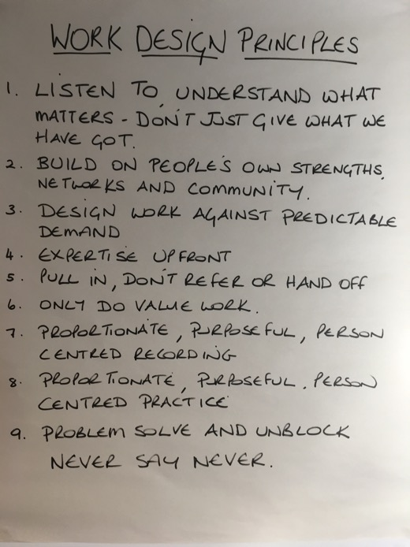

Slide 4
Changing Thinking
Rational
Coercive
Normative

Slide 5
Change should be based on knowledge not opinion
Understand
Check
Make normal
Experiment
Do
Plan

Slide 6
The Long Weekend - Design
Unlearn - 3 Days
  Ask People we are there to support - What Matters
  Structured Case File Review
  Listen to small sample of Demand
  Mapping Flow - high level system picture
  Current Logics and Assumptions
Learn - 3 Days
  Purpose
  New Principles
  Measures
  Value Steps
  Build a Plan on Paper

Slide 7
What matters to people in these systems about how we should work with them?
On Your Tables:
List What Matters to people in your system.
- 10 minutes please
- these may be assumptions at this stage

Slide 8
File Reviews
Map the steps in the case on a flipchart.
Did we know what matters to the person?
If so, when?
Number of assessments.
Number of people involved.
Number of contacts.
Number of handoffs (passed from one person in the system to another).
Any observations about the case.

Slide 9

Case File Data – over last two years
Per Citizen | Mean | Upper Control Limit
Number of Assessments
Number of People Involved
Number of Contacts
7
32
20
69
58
242

Slide 10
Mapping Flow
Flow | Waste | Impact on Citizen | Impact on System
Map the steps here | Show any wastes here, e.g. duplication | E.g. waiting longer than necessary. | e.g. Chasing phone calls, multiple reports taking more capacity than is necessary.

Slide 11
Mapping Flow
“What wastes your time?”
“What gets in the way of you doing what matters to citizens”
“What does the organisation think is important?” / “What does the boss pay attention to?”

Slide 12
What Will Prevent Success?
On Your Tables:
List what could prevent success.
- 10 minutes please
- these may be assumptions at this stage

Slide 13
Essential Components for Success
Leaders undertake the studying.
Debrief the learning around Thinking – System – Performance.
Choose typical not extreme cases.
Plan the logistics well in advance!

Slide 14
Learning What Is Currently Happening
Studying the Current System is Essential
Common and Shared Understanding of What is Happening and Why;
Challenges Assumptions;
Learn What to Give Up and What to Replace It With.

Slide 15
Developing and Sustaining the Different Way of Thinking - Being Deliberate

Slide 16
Debrief Structures
Fishbowl
Hierarchy of Support

Slide 17
Fishbowl
The team member/s who visited the person feedback on the case, without interruption by the rest of the team (max 5 mins).
The rest of the team then ask clarification questions (max 5 mins).
The rest of the team then discuss what they have heard, without interruption by the team members who undertook the visit (max 5 mins).
Whole team then build a plan of action together (max 5 mins).

Slide 18
Hierarchy of Support
Build on the person’s own strengths, current and historical networks; only then
Use Community Resources; only then
Use Statutory or Commissioned Resources.

Slide 19
System Design Frameworks
Blockage Board
Expertise Grid
Measures
Throughput Board.

Slide 20
What You Can Do Tomorrow
Study What Is Currently Happening Together;
Tackle System Conditions Together;
Experiment with New Principles Together.
So Book Your Long Weekend Together…!

Slide 21
Contact Details
simon.pickthall@vanguardwales.co.uk
07951 481878

