Slide 1
Midwifery and Health Visiting in Wales
Karen Jewell
Nursing Officer
Maternity and Early Years
CNO office, Welsh Government

Slide 2
Key Drivers for change

Slide 3

Prudent Healthcare in Wales
(The Bevan Commission 2015)
Achieve health and wellbeing with the public, patients and professionals as equal partners through co-production;
Care for those with the greatest health need first, making the most effective use of all skills and resources;
Do only what is needed, no more, no less; and do no harm.
Reduce inappropriate variation using evidence based practices consistently and transparently.

Slide 4

Children to be given the best start in life from very early years.
Thriving communities built on a strong sense of place.
Valuing our environment.
Investing in growing our local economy.
Reducing inequality and a greater value on diversity.
A stronger citizen voice and active participation in decision making.
Celebrating success, valuing our heritage, culture and language.
Notes:
The shared vision of all strategies in wales is to ensure that the babies in Wales have the best start in life
In Wales there is a cross cutting objective to ensure we are building generations who are healthy and thrive
We must do this in collaboration with statutory and other agencies if we are to succeed
Initiative such as the First 1000 days and cross governmental work are striving to ensure that our work is joined up and that families do not have to navigate through services

Slide 5


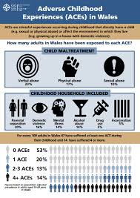

Adverse Childhood Events Wales
http://www.aces.me.uk/in-wales/
Notes:
In relation to co-production and ensuring all services are linked
The evidence on ACEs which we may have always had some gut feeling about now shows firm connections between Adverse Childhood events
Evidence shows children who experience stressful and poor quality childhoods are more likely to develop health-harming and anti-social behaviours, more likely to perform poorly in school, more likely to be involved in crime and ultimately less likely to be a productive member of society.
suffering four or more harmful experiences in childhood increases the chances of high-risk drinking in adulthood by four times, being a smoker by six times and being involved in violence in the last year by around 14 times.

Slide 6


Prosperity is not just about material wealth – it is about every one of us having a good quality of life, and living in strong, safe communities
Five Key Themes
Prosperous and Secure
Healthy and Active
Ambitious and Learning
United and Connected
Priority Areas
Early Years
Housing
Social Care
Mental Health
Skills and Employability
Notes:
6
Prosperity for All is a strategy to take forward the programme for Government until 2021
It acknowledges that HOW we deliver is as important as WHAT we deliver and in order to make a real difference to peoples lives we need to do things differently and involve people in the services they use every day

Slide 7
PARLIAMENTARY REVIEW :The Quadruple Aim (2018)
Underpin the ‘one Vision’ of health and social care with 4 core aims:
Improve population health and wellbeing through a focus on prevention
Improve the experience and quality of care for individuals and families
Enrich the wellbeing, capability and engagement of the health and social care workforce
Increase the value achieved from funding of health and care through improvement, innovation, use of best practice, and eliminating waste

Slide 8
A Healthier wales (2018)
Five key aims:
The health and social care system will work together to provide seamless care. Local services will share best practice and scale up local solutions
Services will be provided closer to the community and more provision of early intervention services to stop people becoming ill
To get better at measuring what really matters to people to inform future service provision
To make Wales a great place to work in health and social services and invest in new technologies which will make a real difference to services.
To make our services work as a single system, we need everyone to work together.

Slide 9
Midwifery
A new strategy

Slide 10
The Lancet 2014
Notes:
The Lancet Series on Midwifery published in 2014 is the most critical, wide-reaching and high profile examination of global midwifery to date and provides clear knowledge on the benefits of midwives and evidence-based midwifery.
The Lancet series findings and recommendations underline the importance of education throughout the life course and this framework provides the clear evidence for what women and families can expect from a maternity service, with clear distinction of values and philosophy that should underpin not just the service provided but also the education of those who work with women, babies and families.
It would be prudent therefore in Wales to be utilising this framework to develop the maternity strategy as well as to develop education of our future workforce.
The NMC is currently utilising the Lancet framework to develop new standards of proficiency for midwifery education.
So let’s consider some of the principles on which education should be based:

Slide 11
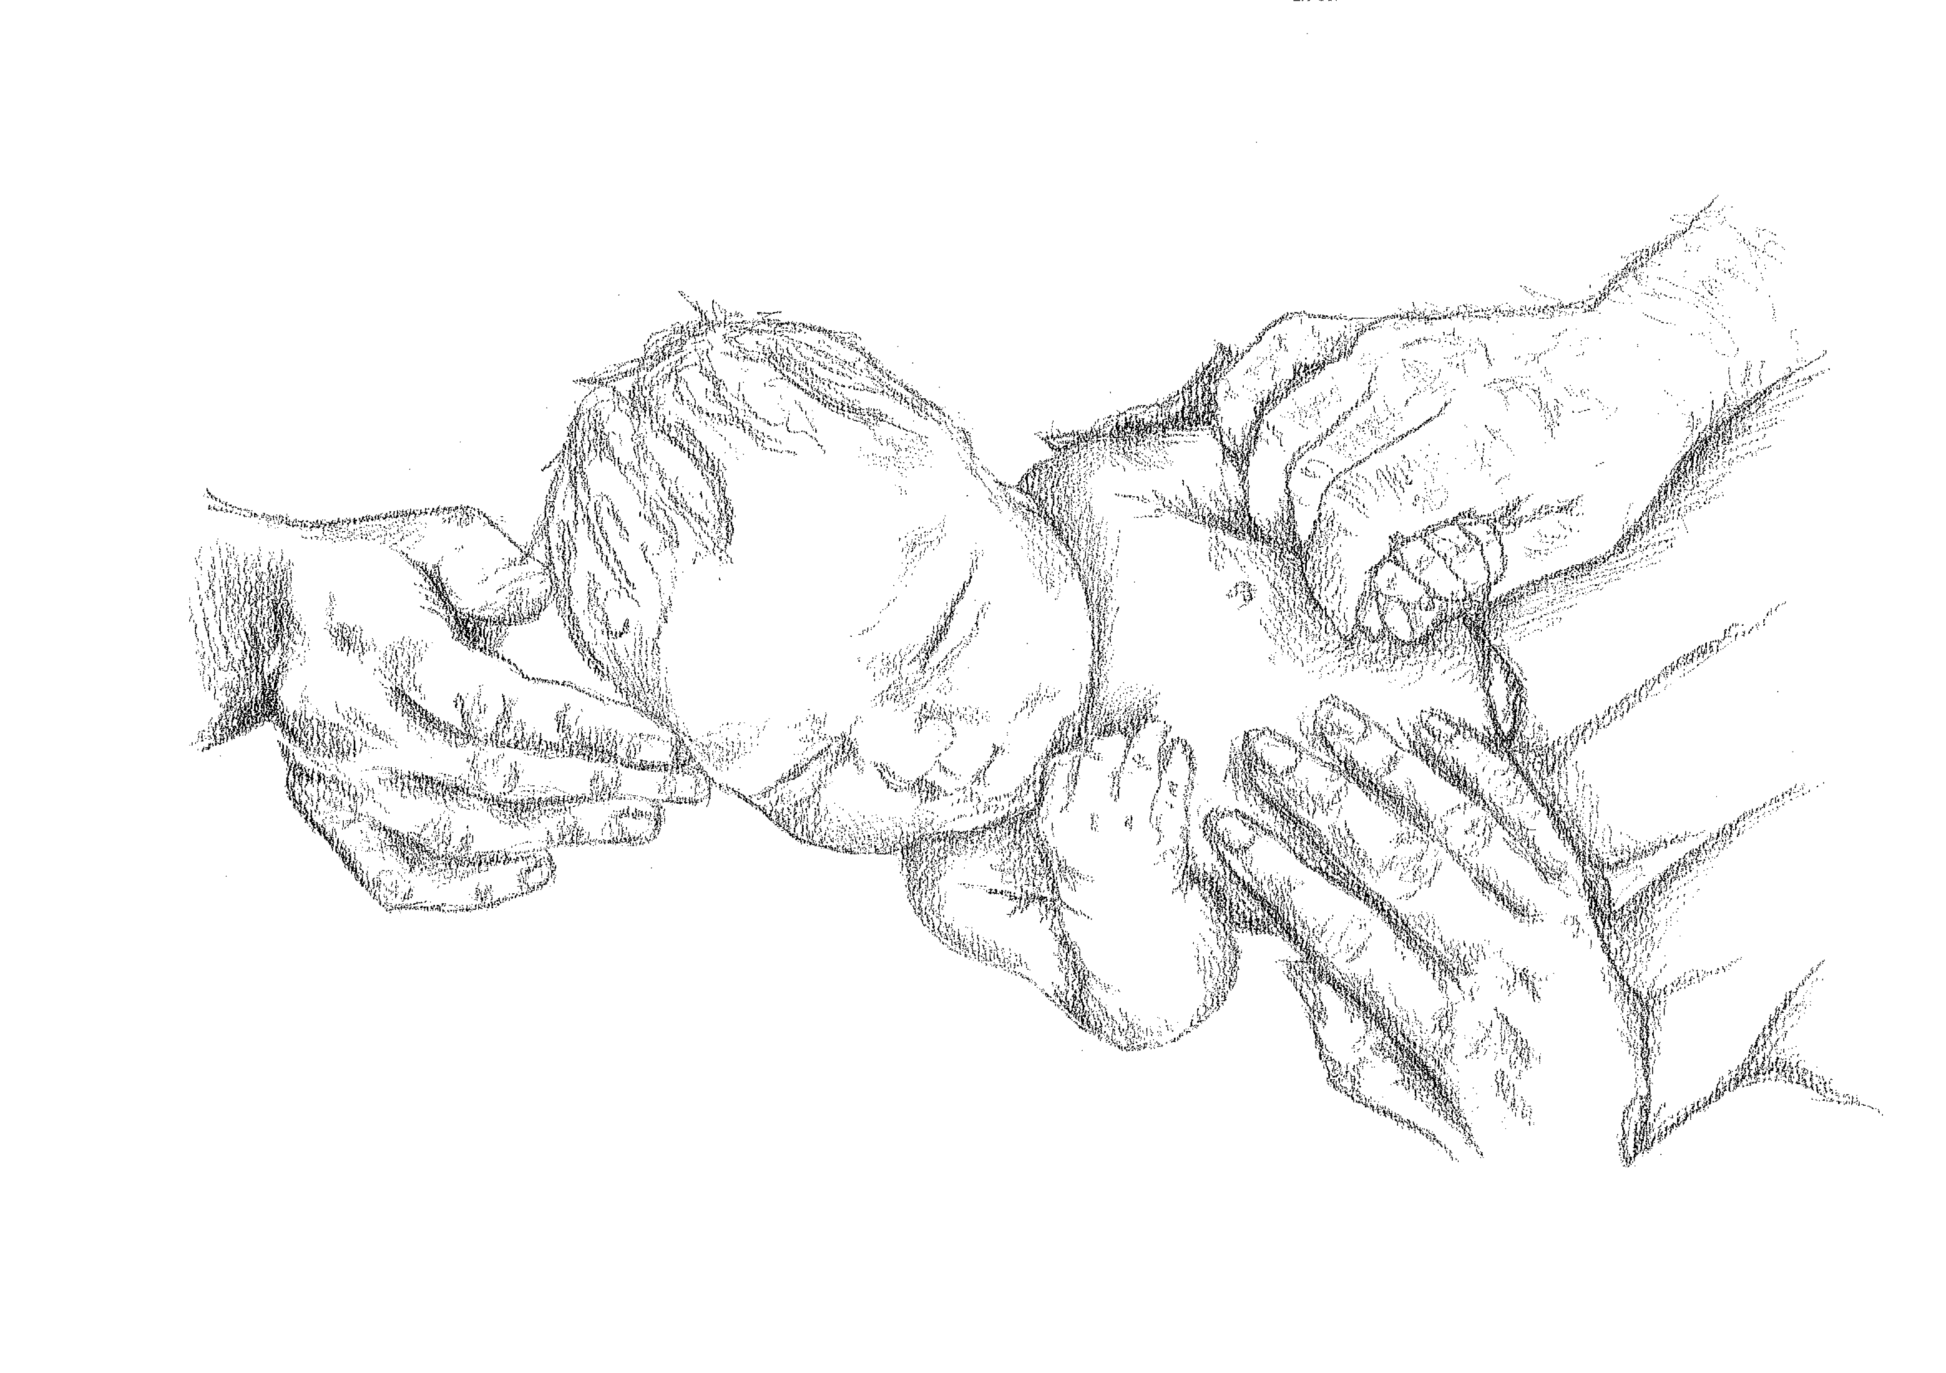
What women and Midwives want

Slide 12
Overall Aim of new vision
Our vision for maternity services in Wales is to ensure that:
‘Pregnancy and childbirth are a safe and positive experience, and parents are supported to give their child the best start in life.’
High performing multi professional teams will deliver family-centred care within Health Boards which display strong leadership within a culture of research and development, continuous learning, best practice and innovation.

Slide 13


KEY Themes of new vision
Family Centred Care
Women will receive personalised care planned in
partnership with them and will reflect their
choices and health needs.
Continuity of carer
Women will experience continuity of care
and carer across the whole of their
maternity journey.

Slide 14


KEY Themes of new vision
Safe, effective care
Women will receive safe, effective care,
with risk, intervention and variation
reduced wherever possible.
Skilled multi professional team
Women will receive care from multi-professional
teams, with access to specialist services
when required.

Slide 15

KEY Themes of new vision
Sustainable quality services
Women will receive maternity services which
are sustainable and the highest
quality possible.

Slide 16
Health Visiting
A team around the family concept

Slide 17
The role of the health visitor
The 1000 days parental insights report (2017) identifies the key role that Health Visitors have in supporting families in this critical period, it highlights the importance of building good relationships with clients and being able to deliver interventions and key contacts in the home.

Slide 18
Current service provision
Currently the Health Visiting service in Wales is predominantly staffed by band six nurses/midwives who have undertaken the Specialist Community Public Health Nursing (SCPHN) course to qualify as Health Visitors.
Caseload average of 250 (Cowley et al 2016)
Skill mix teams currently consist of
band 7 Team Leaders and Practice Teachers
band 4 Community Nursery Nurse
band 2 Administration Staff
Healthy Child Wales Programme 0-5 years (HCWP 2016) 9 contacts
Increasing complexity - FRAIT
National statistics published in November 2018 show that 73% of all contacts which should have been offered to eligible children were received.

Slide 19
Age profile

Slide 20
Future proofing
The current model of delivering Health Visiting services in Wales is not prudent, equitable, or sustainable
Work stream outcomes
  Skill Mix – coordinate and develop all Wales job descriptions to support skill mix within Health Visiting teams.
  HCWP – revise the HCWP/Flying Start to enable a prudent team approach.
  Acuity – Link with the work of the National Staffing Act.
  Future Services – To link with early years pathfinders and projects.
  Role and Purpose – to identify a future model for Health Visiting within an early year’s model.

