Slide 1
Mums Matter
A Perinatal Mental Health Community Pathway
Natalie Davies
Mind Cymru

Slide 2
Contents
Current context of perinatal mental health service provision in Wales
Universal and community perinatal mental health referral pathways
Mind’s Mums Matter perinatal mental health service

Slide 3
Perinatal Mental Health
10-20% of mothers are affected by perinatal mental illness (NICE, 2014).
Suicide is the leading cause of direct maternal death in the perinatal period (MBRRACE, 2019).
Notes:
Current state of issue:
Mental health problems are single biggest health threat to a woman during the perinatal period. Perinatal mh problems affect 10-20% of women and at its worst leads to suicide, which remains the leading direct cause of death in the perinatal period. These issues are estimated to cost the UK £8.1 billion per year, approximately £10,000 per child.

Slide 4
Perinatal Mental Health
31,274 live births in Wales in 2018 (Office for National Statistics, 2019)
Meaning approximately 3127-6255 women in Wales are currently experiencing a perinatal mental health problem as a conservative estimate
Notes:
Across Wales there were 31,724 live births in 2018 meaning there are approximately 3127-6255 women currently experiencing these mental health issues.
“Many of the negative impacts of these conditions can however be mitigated through early identification and prompt treatment by universal and specialist services.” perinatal mental health inquiry 2017
This is an update to statistics since the last perinatal inquiry held by the Children and Young People and Education Committee in Oct 2017.

Slide 5
Progress
There has been important progress in the provision of perinatal mental health care in Wales:
  Specialist community perinatal mental health services
  The work of the 3rd sector in enhancing specialist perinatal mental health provision
  Plans for a mother and baby unit in Wales
  Establishing a National Clinical Lead for perinatal mental health, a Perinatal Mental Health Network & Board
  The ambition to meet CCQI standards by March 2021

Slide 6
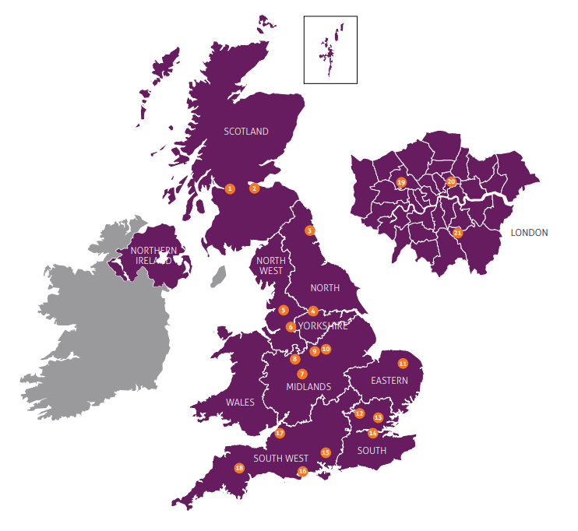
Wales Perinatal Context
Currently there is no mother and baby unit in Wales
Variation in specialist provision by area
Non equitable service depending on geographical location
Multiple barriers to accessing support
Awareness, information and training isn’t clear and consistent
EU funding cuts & considerations
Identified by Mind and the perinatal mental health in Wales inquiry

Slide 7
Universal Pathway
From bumps to babies: perinatal mental health care in Wales (2018) recommended:
  Training and up-skilling of a range of healthcare professionals around perinatal mental health (61% of health professionals had not received training)
  The All Wales Perinatal Mental Health Steering Group to complete the training and competency model for Wales
  An increase in clear and consistent information on perinatal mental health to increase awareness and dispel myths
  A partnership approach to perinatal mental health

Slide 8
Community Pathway
Early identification alone does not benefit women and their families, as it needs to be supported by clear referral and care pathways (Howard et al 2018).
Women who are at risk of or suffering from perinatal mental health problems will require a range of different support depending on their needs and the severity of the condition (Royal College of Midwives, 2014).

Slide 9
Community Pathway
Treatment and support for perinatal mental health problems is provided by a combination of universal and specialist services, and can range from community based therapeutic support for women with mild conditions, through medication and specialist in-patient care for women experiencing moderate to severe mental health conditions (Royal College of Midwives, 2014)

Slide 10

Mind’s Perinatal Mental Health Service

Slide 11

Co-designed by mums for mums
Co-production is at the heart of Mind’s Service Design methodology

Slide 12
Mums Matter Service Model
Mums Matter is a structured six-week course consisting of 2 hour weekly sessions for mums who are feeling low, stressed, overwhelmed, anxious or having worrying thoughts and feelings; and are struggling with the transition to motherhood.
Mums Matter provides a safe space for mums to come together and share their experiences:
Dispelling the myths about the ‘perfect mum’
Enabling mums to learn different tools to manage their everyday
Supporting mums in nurturing themselves
Facilitated by a Mind practitioner and a mum with lived experience, with crèche facilities provided on-site.

Slide 13
Benefits of Mums Matter
Co-produced with mums with lived experience of perinatal mental health problems
Developed using Mind’s Service Design methodology
Cost effective, replicable and scalable
Local community based service
A mild to moderate perinatal mental health referral pathway / service
Assessment is aligned with NICE safety and referral pathway guidelines
Offers continuity of care; an assessment with a Mind practitioner, group support, peer support and volunteering opportunities
Facilitated delivery, safeguarding procedures and referral feedback

Slide 14
Mums Matter Outcomes
Mums Matter was piloted and evaluated in two local Minds – Brecon and District Mind and Mid-Powys Mind with funding from Comic Relief
123 participants took part in the pilot over 2 years
GAD 7, PHQ 9, WEMWBS & SPS-10 used as outcome measures

Slide 15
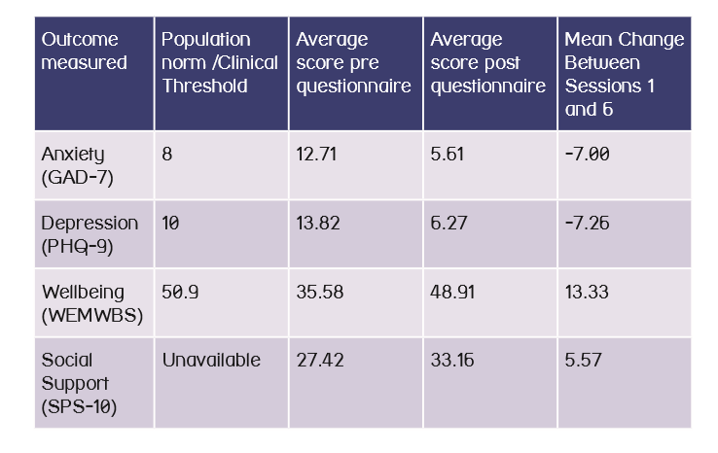
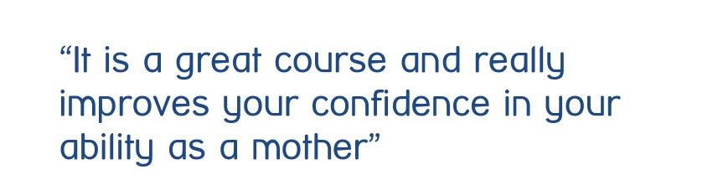
79% recovering from anxiety
72% recovering from depression
95% improvement in wellbeing by the end of the programme
Notes:
72% of participants had recovered and no longer met clinical thresholds for anxiety (GAD-7*).
79% of the participants recovered and no longer met clinical thresholds for depression (PHQ-9*).
95% of participants who completed Mums Matter had improved wellbeing (WEMWBS*).
Mums Matter also improves social connections, with 78% of participants reporting improvements in their sense of belonging and support (SPS-10*).

Slide 16
Our aspirations for Mums Matter and perinatal services
Increased clinical and community based referral pathways and provision for those with perinatal mental health problems
National delivery of Mums Matter
Increased awareness, knowledge and skills and reduced stigma
Collaborative multi-agency pathways and approach

Slide 17
Further Information
Replicability
National Mind Quality Assurance
Commissioning Mums Matter
Contact details: servicedevelopment@mind.org.uk
n.davies@mind.org.uk

Slide 18

Thank you for listening.
Any Questions?

