Slide 1
INTEGREIDDIO BLYNYDDOEDD CYNNAR
EARLY YEARS INTEGRATION
Sharon West
Pennaeth Blynyddoedd Cynnar Llywodraeth Cymru/ Head of Early Years Welsh Government

Slide 2
PAM BLYNYDDOEDD CYNNAR/ WHY EARLY YEARS
Notes:
Early Years in Wales is 0-7,conception to the end of Foundation Phase.
Critical years - laying the foundation for lifelong well-being.
Early brain development
Impact of ACES
Regular contact with wide range public services

Slide 3
INTEGREIDDIO BLYNYDDOEDD CYNNAR EARLY YEARS INTEGRATION
‘adeiladu ar ein rhaglenni presennol ar gyfer y blynyddoedd cynnar a chreu system fwy cydgysylltiedig ac ymatebol a fydd yn rhoi lle canolog i anghenion unigryw pob plentyn.’ Ffyniant i Bawb – y Strategaeth Genedlaethol (Llywodraeth Cymru) | ‘build on our current early years programmes and create a more joined-up, responsive system that puts the unique needs of each child at its heart.’ Prosperity for All – the National Strategy (Welsh Government)

Slide 4
SYSTEM BLYNYDDOEDD CYNNAR EARLY YEARS SYSTEM

Slide 5
SYSTEM BLYNYDDOEDD CYNNAR EARLY YEARS SYSTEM
CWM TAF
Camau Cwmpasu’r dull Canfod ffeithiau a mapio Gweithredu’n Gynnar: Dylunio, Profi, Gwella a Gwerthuso Cyflawni Rhoi ar waith | Phases Scoping the approach Fact finding and mapping Early Implementation: Design, Testing, Improving and Evaluation Delivery Roll out

Slide 6
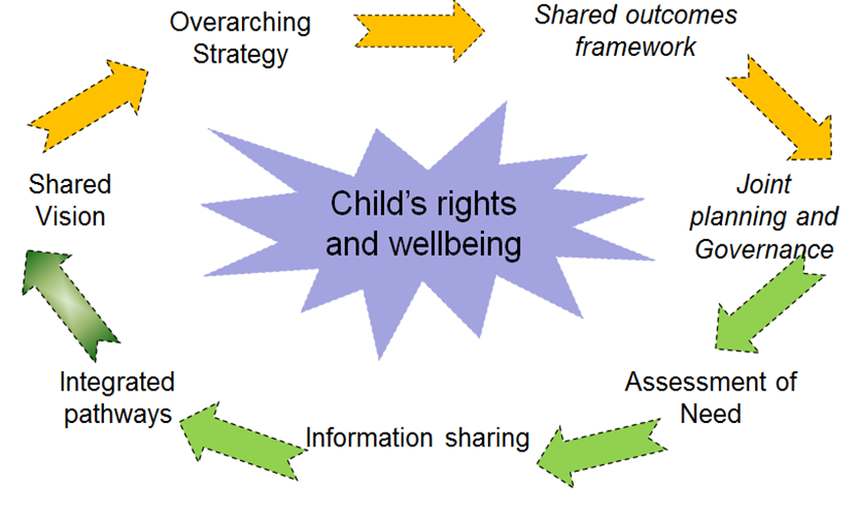
CYDRANNAU CRAIDD CORE COMPONENTS

Slide 7
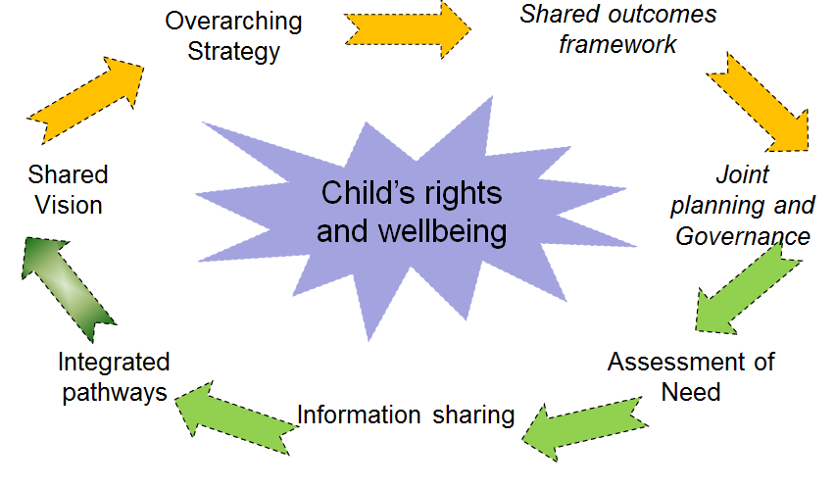
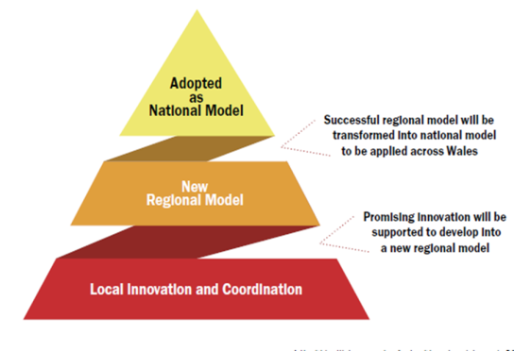
Fframwaith Cenedlaethol/ National Framework
Toolkit and Guidance
Models of integration
Health Visiting
Information Sharing
Integrated Family Support (TAF)
Research
Transformation Fund
Invest to Save
PATHFINDERS
(local testing)

Slide 8
BLYNYDDOEDD CYNNAR: CAMAU NESAF EARLY YEARS: NEXT STEPS
‘Pathfinders’: Llunio ein cynllun, egwyddorion a blaenoriaethau Adborth ar ein syniadau polisi Ein helpu i ddeall y rhwystrau a dod o hyd i atebion | Pathfinders : Shape our plan, principles and priorities Feedback on our policy thinking Help us understand barriers and solutions

Slide 9
PATHFINDERS
CYNLLUN PROSIECT/ PROJECT PLAN
Pathfinder workshops
PSB Project
Feb
PSB Sign up
Visioning
Scoping
March -April
Mapping Approaches
Theory of Change
Fact Finding/ Mapping
Identify gaps/blocks/ level of integration. Theory of change
May-
June
Design and Planning
DESIGN
Develop Implementation plans
National Framework
Implementation
testing and learning
July- Sept
Share learning/barriers
Notes:
Pathfinders will have a key role
Pathfinder workshops will be held every 2 months. Opportunity for team members to meet - to discuss each stage of the project with each other and experts/academics through presentations, workshops and lessons learned. Link to a dedicated Project Manager in WG. The programme will flex, especially from September as we identify the challenges and barriers that pathfinders are facing.

Slide 10
Pathfinder Workshops
Local Steering Group
Includes: LA and Health board leads
Scoping&
Mapping
Design&
Planning
Implementation
Testing
ONGOING EVALUATION
Notes:
The Pathfinder workshops will set the framework and direction of travel. Locally the Pathfinders will follow the stages within their local projects : hand out.

Slide 11
Cynnig Llywodraeth Cymru/ Welsh Government Offer
Rheolwr Prosiect Grant ar gyfer cymorth prosiect Gweithdai ‘Pathfinder’ Cymuned Maes Hyb TGCh Gwerthuso Cyfleoedd i ddileu/lleihau rhwystrau. Digwyddiad Cymru Gyfan yn yr Hydref. | Project Manager Grant for project support Pathfinder workshops Community of Practice ICT hub Evaluation Opportunities to remove/reduce blockages All Wales event in Autumn.

Slide 12
First 1000 Days
Early Years Integration Programme
Objectives
Optimal outcomes from every pregnancy for mother and child,
Children achieving their developmental outcomes at age 2,
Fewer children exposed to adverse childhood experiences (ACEs) in the first 1000 days.
Objectives
Children from all backgrounds have the best start in life
Parents will have access to a joined up and seamless EY service
Fully professionalised EY workforce – who feel part of a single EY system
More confident parents of happy, confident, thriving, resilient children
Reduced educational inequalities , reduction in ACEs
Pregnancy- 2 years
Pregnancy-7 years
Informs policy-setting and aims to make improvements within current policy parameters
Shapes and reviews policy – challenges current policy parameters
Early intervention and prevention
Works at PSB and practitioner level to support local system development and identify areas for improvement
Intensive co-construction at decision maker level with pathfinder PSBs to explore reconfiguring the EY system
Learn from and spread best practice
Develop a solid evidence-base, products and toolkits to inform the development of policies and quality interventions
Improve effectiveness of transition-points: horizontally, between services, and vertically, between levels of service
Build capacity in and across the workforce
Build a Wales-wide professional network of practitioners involved in F1000D
Systems approach
Ensure better intelligence-sharing between practitioners/agencies
Public-facing communication to emphasise the importance of the F1000D
Explore how we can reach more families in need of intensive support

Slide 13
BLYNYDDOEDD CYNNAR EARLY YEARS
Am fwy o wybodaeth cysylltwch â/ For more information contact: Sharon West Sharon.west@gov.wales Ffôn/Tel: 0300 025 7433 Alwena Watkins Alwena.Watkins@gov.wales Ffôn/Tel: 0300 025 3104

